Slide 1
Track and field contingency group
OREGON SCHOOL ACTIVITIES ASSOCIATION

Slide 2
purpose
To develop a set of recommendations that can be presented to the OSAA Executive Board to help our member schools with guidance and a comprehensive set of guidelines specific to the activity.
What we develop and recommend will be impacted by the decisions of other entities - the situation continues to evolve and we should be prepared for changes to occur.

Slide 3
What we can anticipate
Things are going to change (medically and legislatively)
Postponements and cancellations will most likely occur due to outbreaks
Not every activity will look the same
Potential travel restrictions (due to costs and availability)
Continued restriction on group gathering sizes

Slide 4
OSAA Calendar

Slide 5
What we know
Season 3 April 5- May 23
5 Days of Practice Required (Unless student participated in a Season 2 Sport)
Competitions April 12- May 16
Culminating Week May 17-23
Participation Limitations
8 Dates for each level of competition (e.g. Varsity, JV, Frosh)
Does not include District/League Tournament or Culminating Week competitions

Slide 6
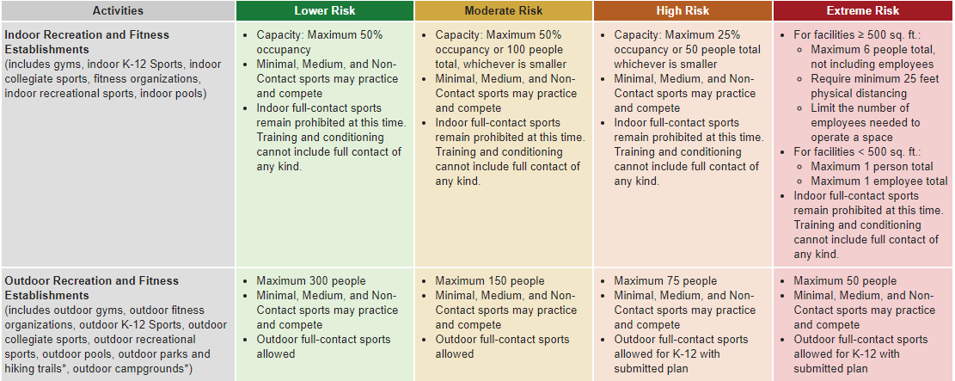

Slide 7
Covid-19 Considerations for track
Masks are required to be worn at all times for practices and competitions – failing to model correct behaviors leads to poor results
Promote physical distancing whenever possible.
Do not share equipment! – schools should provide their own implements and other necessary equipment to limit your responsibilities regarding COVID protocols.
Forget the tarp – Vertical jumps conducted normally.
Bigger is not better – start small and review and correct protocols if needed.
COVID has not disappeared – consider cohorts as much as possible.

Slide 8
Meeting Focus
Is a State Championship the right thing to do?
Do you think it is possible to use our traditional method of qualifying athletes via District Meets? If no, what is your method to replace it?
Splitting into 6 separate Championships is the most feasible option. Reducing the field size may be appropriate and necessary. How do you feel about that?

Slide 9
What’s Ahead?
OSAA Executive Board scheduled to meet on March 17 and 31
Season 3 Plan Books will be posted by next week
Next Contingency Group Meeting- TBD

