Slide 1
2024-25 NFHS Softball rules powerpoint
Rule Changes Major Editorial Changes Points of Emphasis

Slide 2
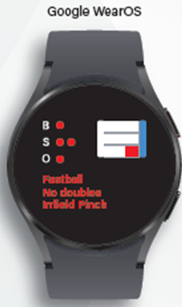
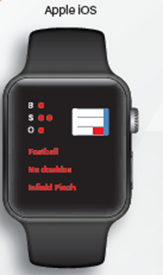
SportsCom – Delivering affordable on-field technology
Customizable Experience
Simple setup, easy to use!
Ability to add your play calls with your terminology
No limitations on number of plays or play groupings
No proprietary hardware to purchase
BYOD Apple or Google watches
Or purchase from our partners at incredibly discounted prices
Encrypted, silent play call communication speeds up the game and secures your play calls
Visual design with easy-to-read display even in the brightest sunlight
Data Driven and Forward Thinking
Full analytics support
Every play call saved
B/S/O data enabled
Fully exportable for your statistical needs
Q1 2024 release schedule; analytics expansion
Complete electronic pitcher and hitter charting feature
Overlayed on your play calling data
Completely free of charge!
Ongoing strategic partner review
SportsCom is dedicated to providing you modern solutions, allowing you to focus on coaching and mentoring your players
Contact: sales@sportscomapp.com

Slide 3
About the NFHS

Slide 4
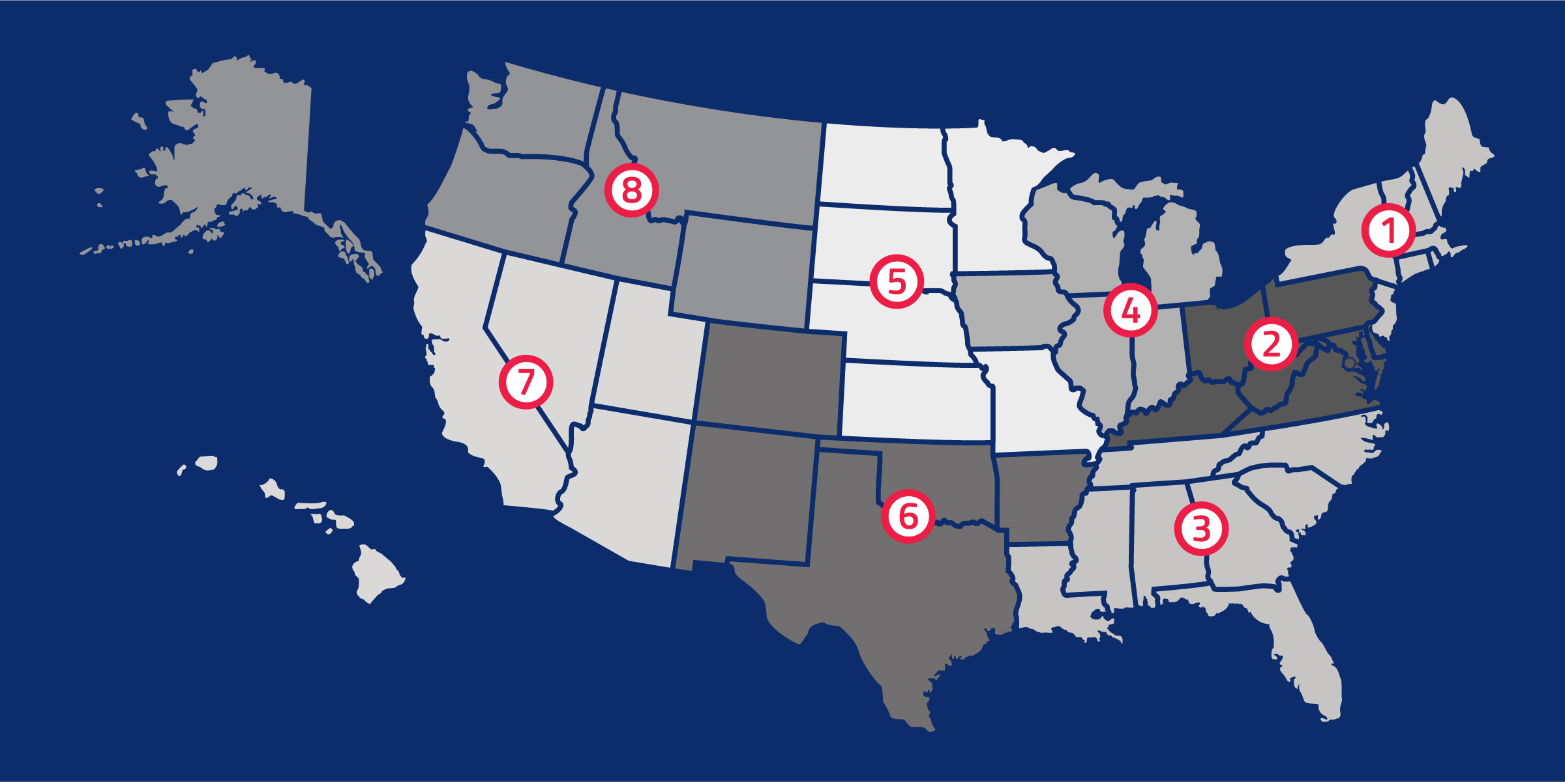
National Federation of State High School Associations
NFHS (located in Indianapolis, IN – Est. 1920):
National leader and advocate for high school athletics and performing arts programs.
Serves 51 state associations, 19,500 high schools and 12 million student participants.
Writes playing rules for 17 high school sports for boys and girls.
Offers online education courses for high school coaches, officials, parents, students and others.
Ensures that students have opportunity to enjoy healthy participation, achievement and good sportsmanship in education-based athletics.
Notes:
The NFHS is the national leader and advocate for high school athletics and performing arts programs. Services of the NFHS reach more than 19,000 high schools and 12 million participants throughout the eight NFHS sections across the U.S.
A significant responsibility of the NFHS is the commitment to writing quality playing rules for 17 high school sports for boys and girls, in addition to providing educational resources for high school coaches, officials, parents and students.
It is the vision of the NFHS to help prepare tomorrow’s leaders for the next level of life through the many program offerings in education-based athletics and activities.

Slide 5
NFHS Rules Review Committee
The NFHS Rules Review Committee is chaired by the chief operating officer and composed of all rules editors. After each committee concludes its deliberations and has adopted its recommended changes for the subsequent year, such revisions will be evaluated by the Rules Review Committee.
Davis Whitfield
Chief Operating Officer
Lindsey Atkinson
Basketball, Girls Lacrosse and Volleyball
Bob Colgate
Football and Sports
Medicine
Sandy Searcy
Softball, Swimming & Diving and Water Polo
Elliot Hopkins
Baseball and Wrestling
Julie Cochran
Cross Country, Gymnastics, Field Hockey, Soccer and
Track & Field
James Weaver
Boys Lacrosse
and Spirit
Dan Schuster
Ice Hockey
Notes:
All rules committee recommended rules changes are vetted through the NFHS Rules Review Committee before advancing to the NFHS Board of Directors for final action. The committee, as you see, is comprised of all NFHS Director of Sports and chaired by the NFHS Chief Operating Officer.

Slide 6
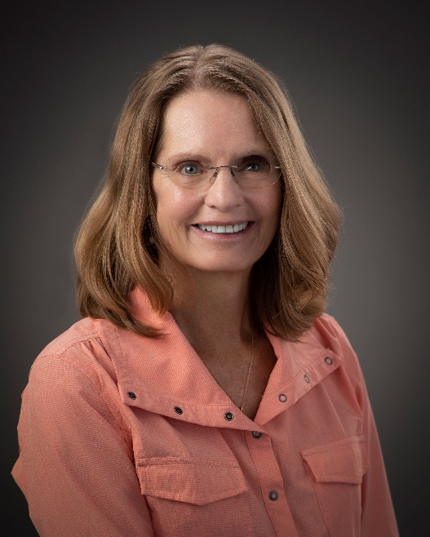
2024 NFHS Rules Committee
Kerrie Rosati Indiana Section 4 - 2027
Dr. Karissa Niehoff
NFHS
Publisher
Sandy Searcy
NFHS
Editor
Andi Osters
Michigan
Chair - 2026
Dennis Crowe
Maine Section 1 - 2024
Sarah Bridenbaugh
Kentucky
Section 2 - 2025
Michelle Yeater
South Carolina
Section 3 - 2026
Kerrie Rosati Indiana Section 4 - 2027
Diane Smith
Kansas
Section 5 - 2024
Steve Roberts
Arkansas
Section6 - 2025
Laura Trarger Nevada Section 7 - 2026
Monica Maxwell Oregon
Section 8 - 2027
Tonia Burke
Idaho
Section 8 - 2027
Jenee James NFHS Coaches Association - 2025
Laura Trager
Nevada
Section 7 - 2026
Michiael Shannon
NFHS Officials
Association - 2026
Notes:
Photos of the 2024 NFHS Softball Rules Committee members include the representation of eight sections, the NFHS Officials Association, the NFHS Coaches Association, and Rules Committee Chair.

Slide 7
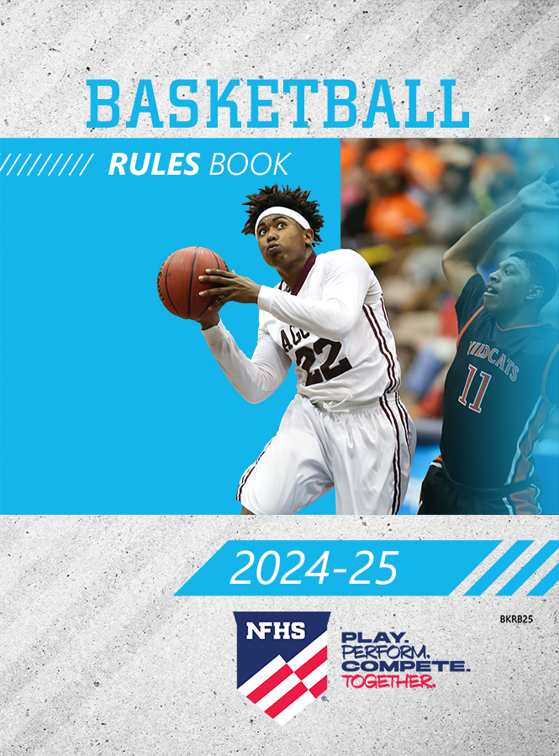
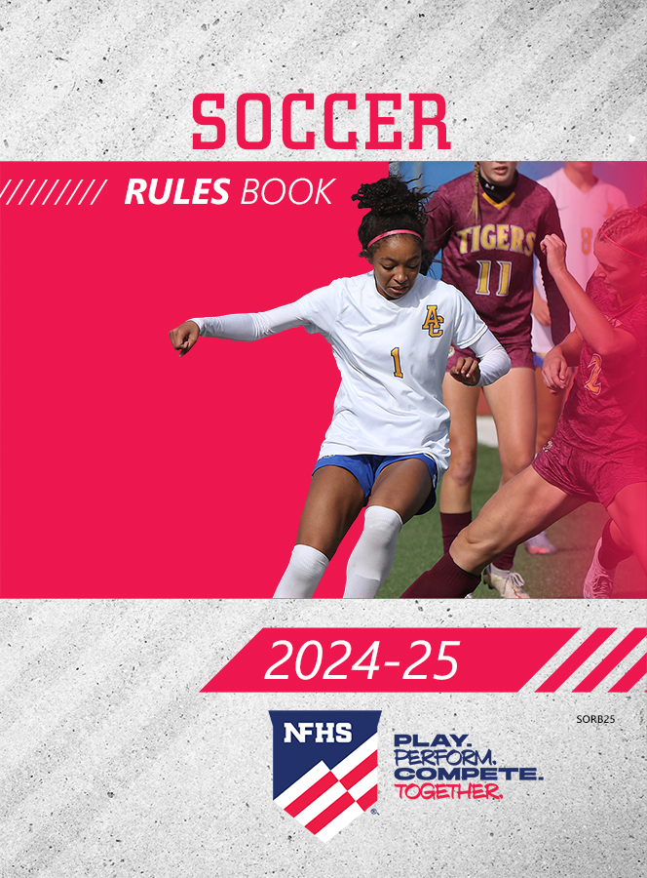
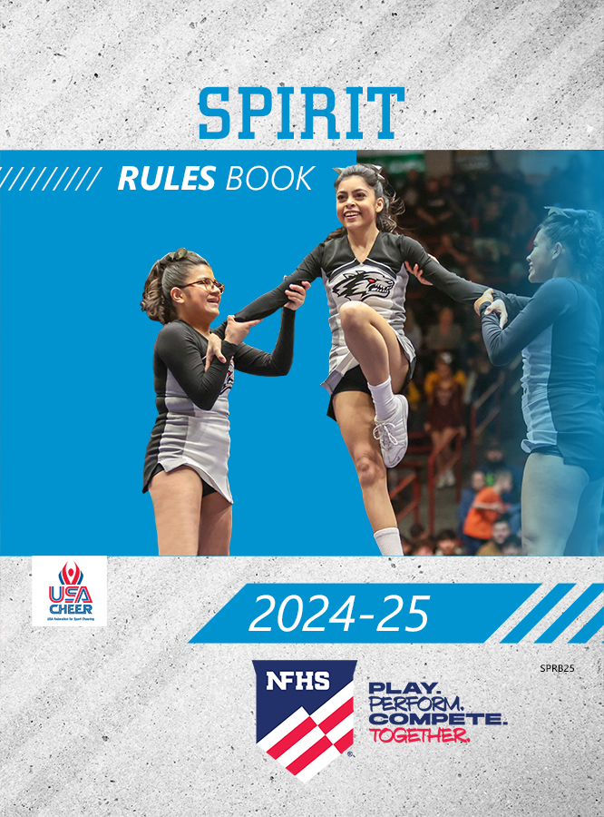
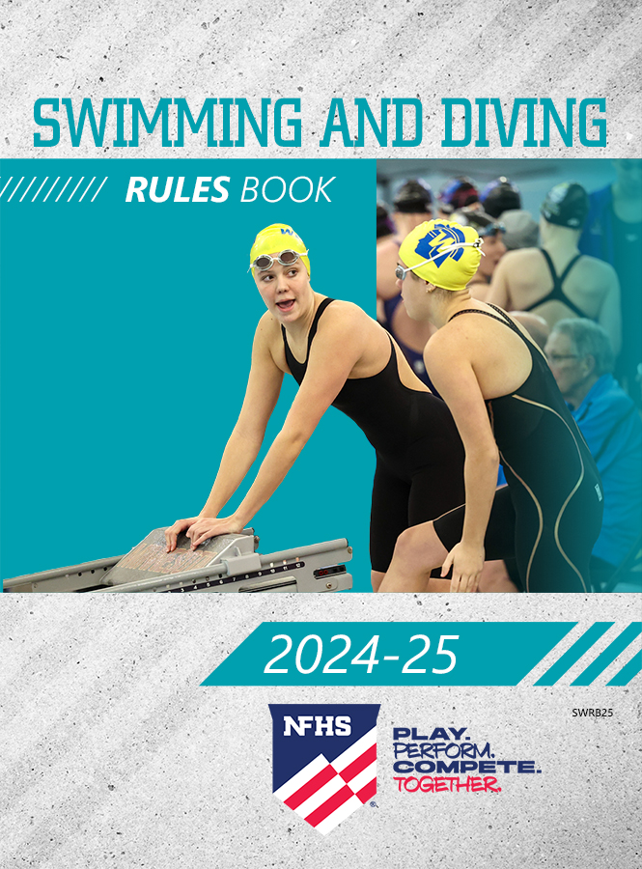
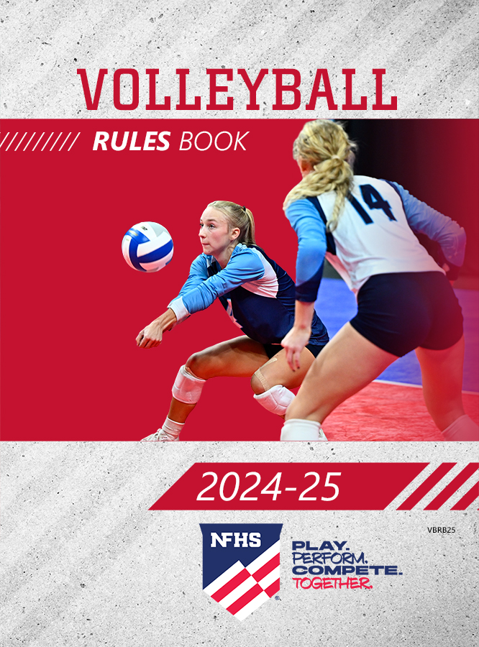
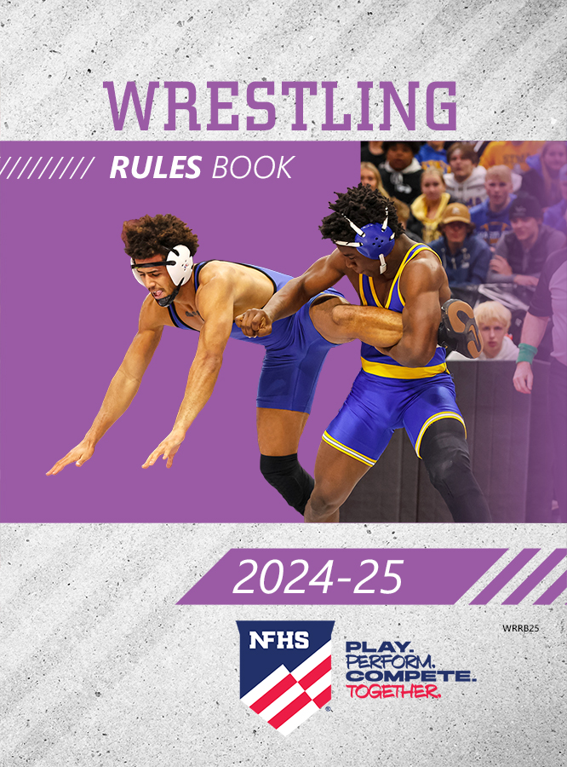
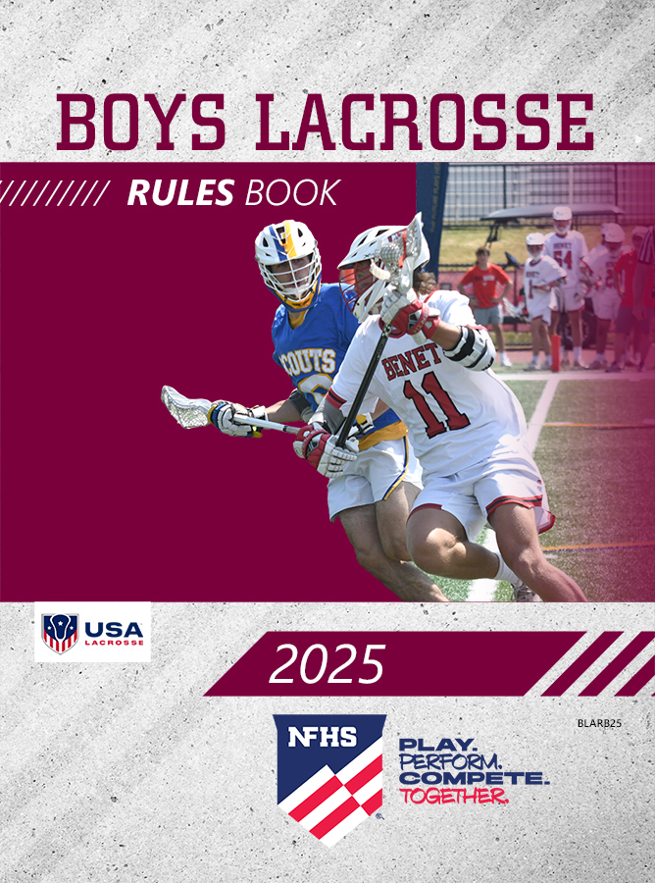
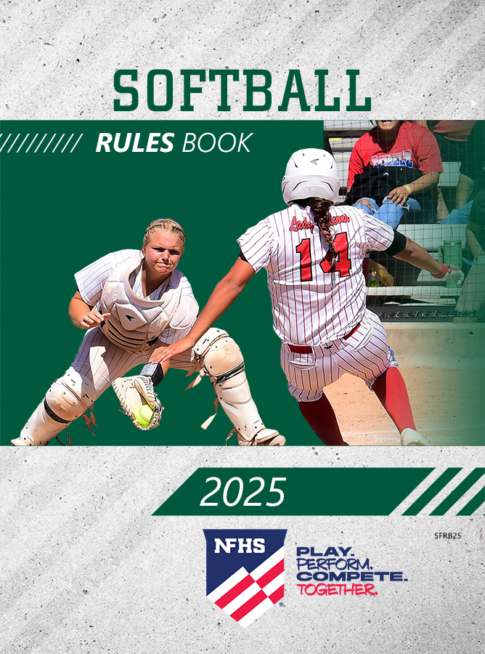
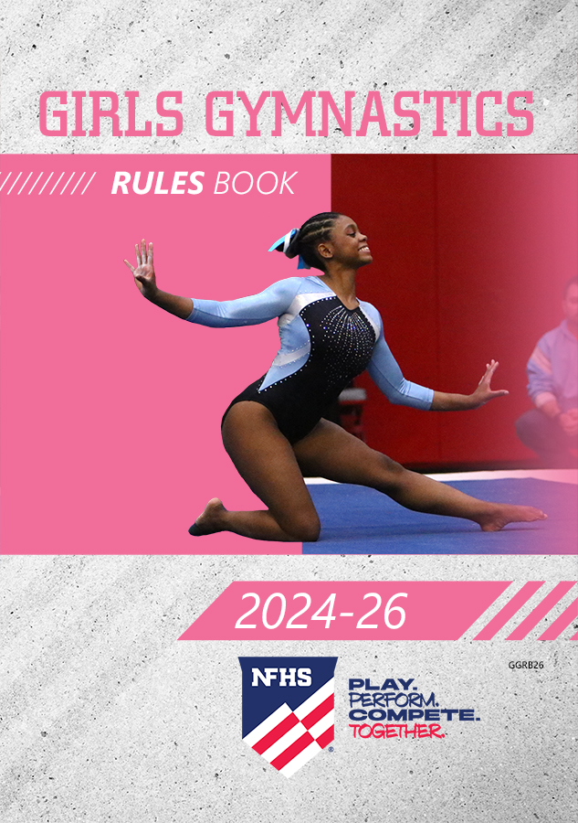
NFHS Publications
The NFHS writes playing rules for 17 sports for boys and girls at the high school level.
Publishes 4 million pieces of materials annually.
Notes:
The NFHS writes playing rules for 17 sports, publishes High School Today (HST) along with several other key publications totaling over four million pieces annually.

Slide 8
NFHS AllAccess – Website
AllAccess is the NFHS Digital Publications Platform that includes:
Rules Publications
High School Today Magazine
Policy Debate Quarterlies
Other NFHS Digital Publications
Website organized for associations and individuals to assign books and manage purchases
Visit https://allaccess.nfhs.org

Slide 9
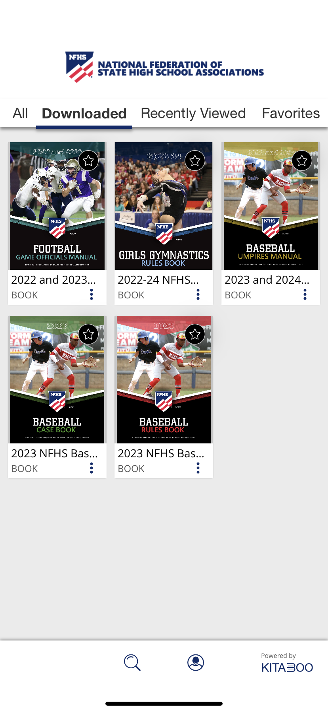
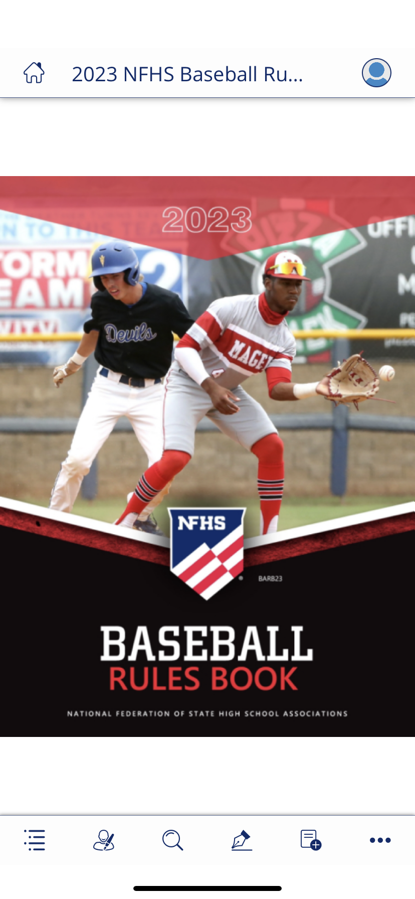
NFHS AllAccess – Mobile App
Access Via Website or Mobile App:
View available publications for sale
View publications assigned to you
Download books for offline viewing
Read publications as an e-book
Available on App Store and Google Play

Slide 10
Guidelines for Schools and state associations for consideration of accommodations
Request of Accommodation by School
State Association Review
Written Determination from State Association
Competition with Approval of Accommodation
Notes:
To assist state associations in working with schools for the inclusion of students with disabilities the following guide prepared by the NFHS Task Force on the Inclusion of Students with Disabilities is being provided for your review.
Following these guidelines will assist in the individual student assessment by the student and the school.
When requesting a possible accommodation, coaches should work with their school and the state association as early as possible in the sport season.
Contest officials shall defer decisions on rule accommodations to the respective state association.
This information serves as a guide. Each state association may develop its own process.

Slide 11
2025 nfhs softball RULES CHANGES

Slide 12
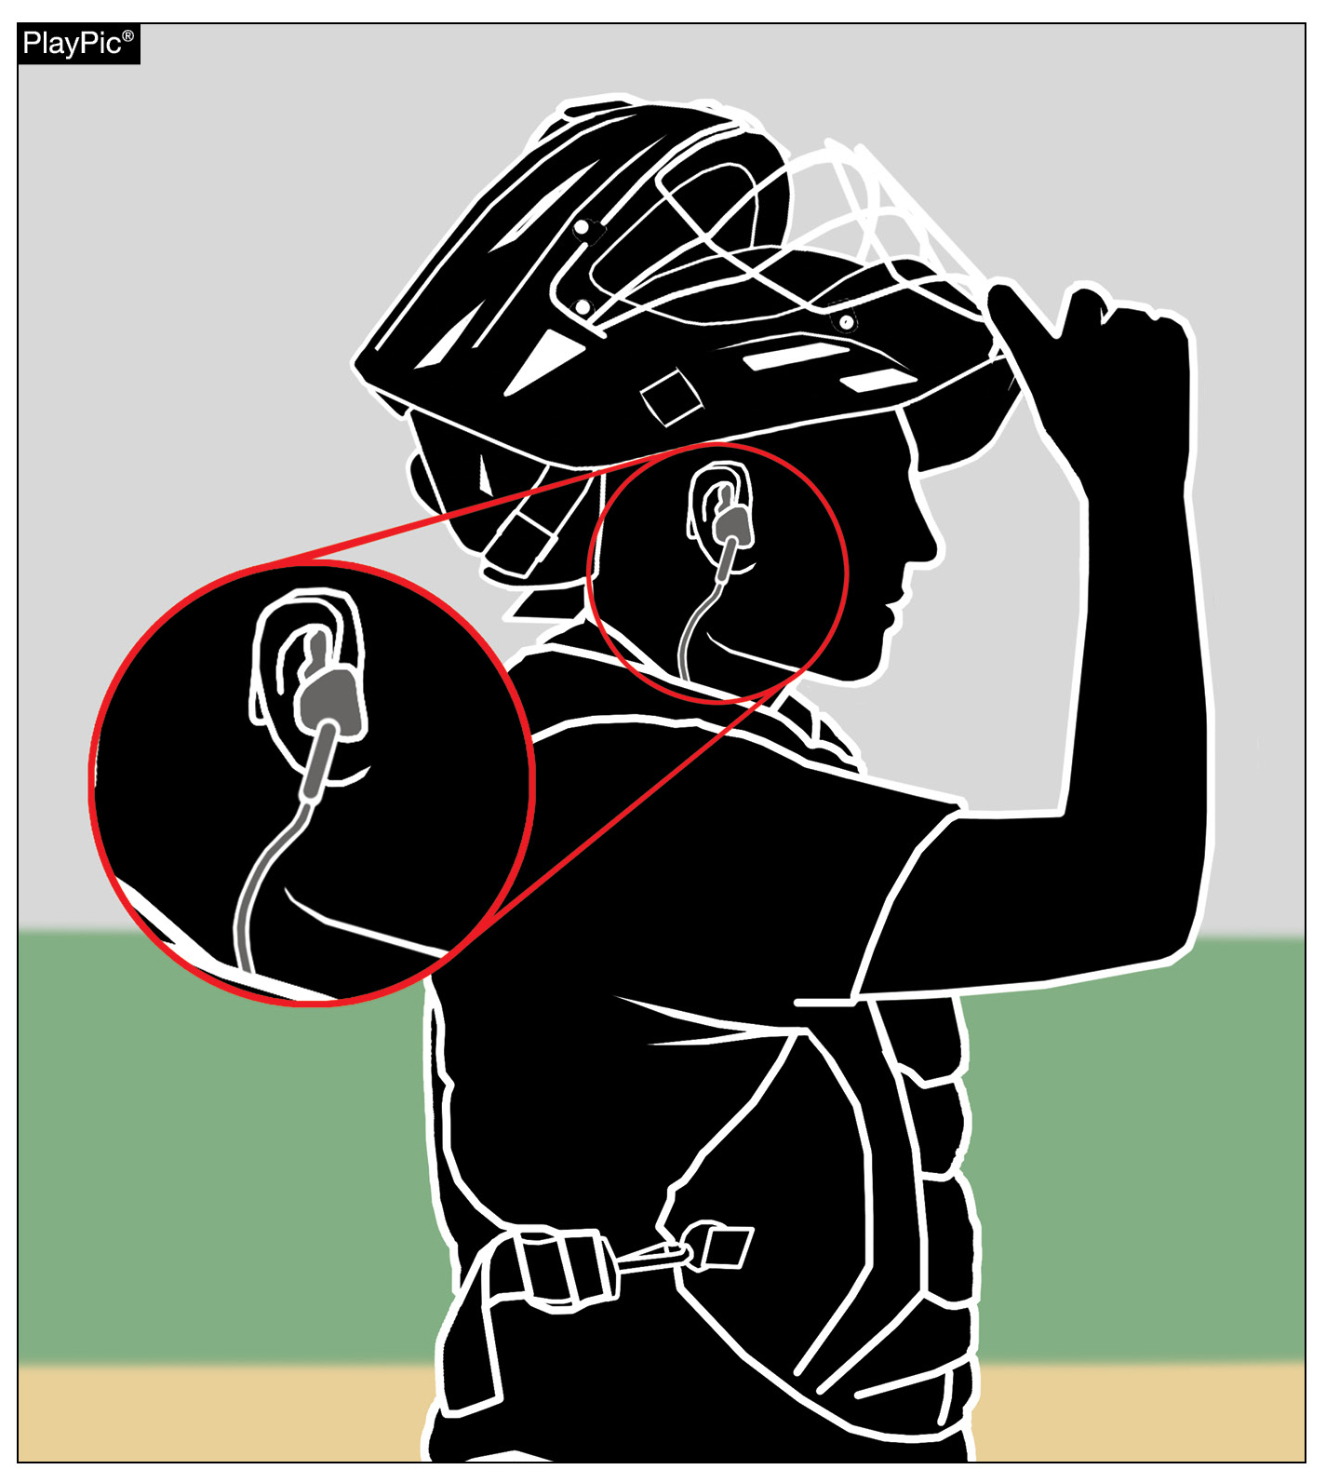
Other equipment 1-8-6 Exception & Penalty
A coach is permitted to use electronic devices in the dugout for one-way communication to the catcher while the team is on defense.
The penalty from Rule 3-6-11 was added to Rule 1-8-6 as well, with violators subject to ejection unless the offense is ruled to be of a minor nature.
Notes:
Rule 1-8-6: A coach is permitted to use electronic devices in the dugout for one-way communication to the catcher while the team is on defense. The penalty from Rule 3-6-11 was added to Rule 1-8-6 as well, with violators subject to ejection unless the offense is ruled to be of a minor nature.
Rationale: The committee has made these changes to support the use of emerging technology within the sport of softball. Being a permissive rule, the use of this one-way electronic communication will allow those who choose to embrace the technology an additional option to communicate with the catcher while on defense.
Comments: A high school softball coach will be able to use electronic devices in the dugout for one-way communication to the catcher while the team is on defense beginning in 2025. This change is the result of analysis of current data, state association experimentation and a positive response from the membership. The committee has made these changes to support the use of emerging technology within the sport of softball. Being a permissive rule, the use of this one-way electronic communication will allow those who choose to embrace the technology an additional option to communicate with the catcher while on defense. It will also maintain the ability for those who prefer a more traditional approach to communicate using signals or a playbook/playcard to continue that approach. Accommodating one-way communication to the catcher brought new language to two different sections of the NFHS Softball Rules Book, starting with Rule 1-8-6. Devices such as earpieces, electronic bands and smartwatches are now permitted as an EXCEPTION within the rule provided the player does not utilize said device to return correspondence to the coaching staff. Since both rules were updated for this change, the penalty from Rule 3-6-11 was added to Rule 1-8-6 as well, with violators subject to ejection unless the offense is ruled to be of a minor nature. This penalty has been in place for Rule 3-6-11 allowing the umpire to issue a warning if the offense is minor and then eject if the offense is repeated.

Slide 13
Bench and field conduct 3-6-11
Communication may only be to the catcher and may not be to any other player on defense or to any offensive player.
While players other than the catcher are permitted to use jewelry, such as watches, they may not use them for the purpose of receiving communication from the dugout. Violators are subject to ejection unless the offense is ruled to be minor in nature.
Notes:
Rule 3-6-11: Communication may only be to the catcher and may not be to any other player on defense or to any offensive player. While players other than the catcher are permitted to use jewelry, such as watches, they may not use them for the purpose of receiving communication from the dugout. Violators are subject to ejection unless the offense is ruled to be minor in nature.
Rationale: Clarifies that a coach may us an electronic device for one-way communication to the catcher while the team is on defense.
Comments: This penalty has been in place for Rule 3-6-11 allowing the umpire to issue a warning if the offense is minor and then eject if the offense is repeated. In addition to permitting the one-way communication devices, the updated version of Rule 3-6-11 regarding Bench and Field Conduct specifies that coaches are prohibited from using the device to communicate with any other team member while on defense or any team member while on offense and the coach cannot use the device outside the dugout/bench area.

Slide 14
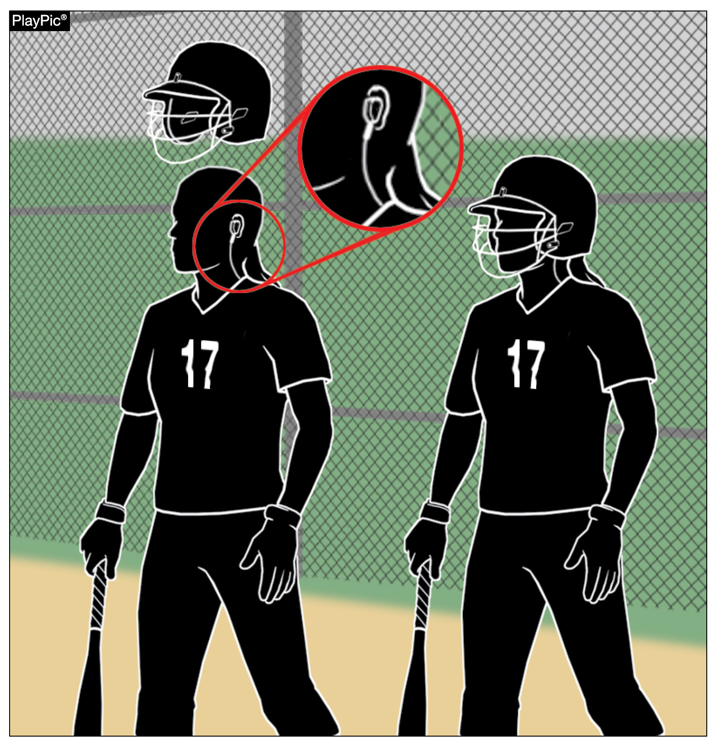
Bench and field conduct 3-6-11
The catcher is not required to remove the one-way communication device while on offense but may not use the device to receive communication.
Notes:
Rule 3-6-11: The catcher is not required to remove the one-way communication device while on offense but may not use the device to receive communication.
Rationale: This rule change specifies that coaches are prohibited from using the device to communicate with any other team member while on defense or any team member while on offense and the coach cannot use the device outside the dugout/bench area.
Comments: In addition to permitting the one-way communication devices, the updated version of Rule 3-6-11 regarding Bench and Field Conduct specifies that coaches are prohibited from using the device to communicate with any other team member while on defense or any team member while on offense and the coach cannot use the device outside the dugout/bench area.

Slide 15
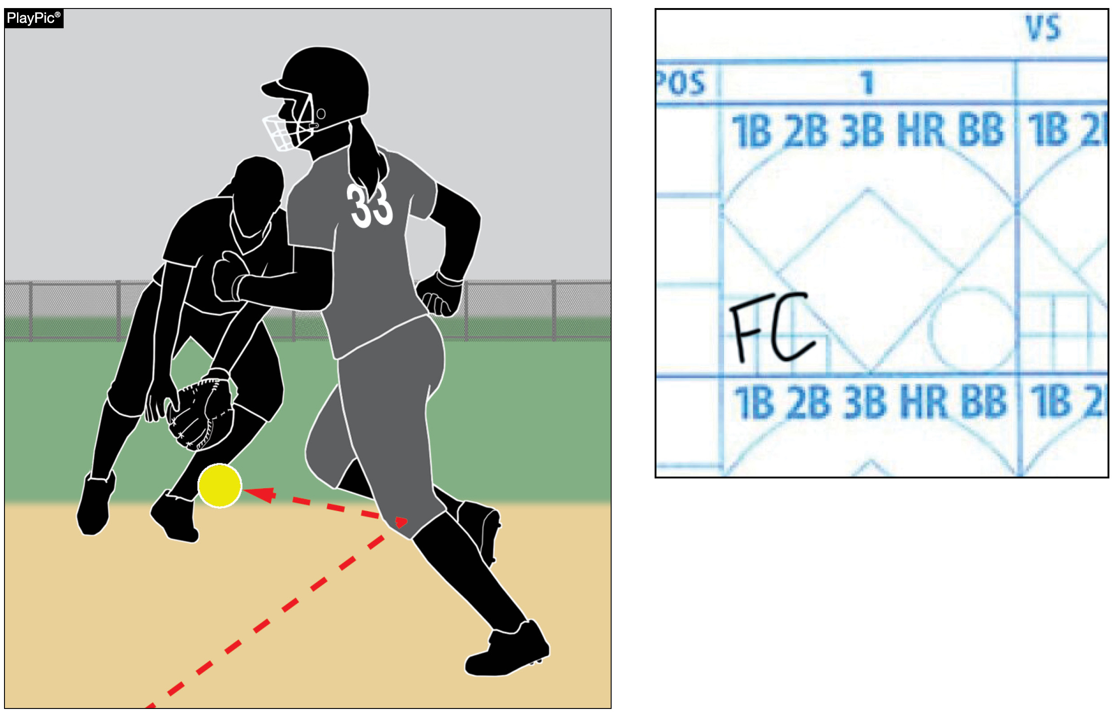
Player’s batting record 9-3-2b
If a batter-runner is awarded first base due to a baserunner’s interference, the batter-runner is credited with a fielder’s choice, not a base hit.
Notes:
Rule 9-3-2b: If a batter-runner is awarded first base due to a baserunner’s interference, the batter-runner is credited with a fielder’s choice, not a base hit.
Rationale: This change corrects an error in the rules book that awarded a base hit in this instance.
Comments: For the purpose of official scorekeeping, if a baserunner is declared out for being hit by a fair batted ball the batter-runner is credited with a fielder’s choice in the scorebook. A runner being hit with a batted ball is a form of interference and is covered in Rule 8-6-11 which specifies that the runner is out and it also lists that the batter-runner is credited with a fielder's choice. Previously, this play was scored as a base hit for the batter.

Slide 16
2025 nfhs softball editorial CHANGES

Slide 17
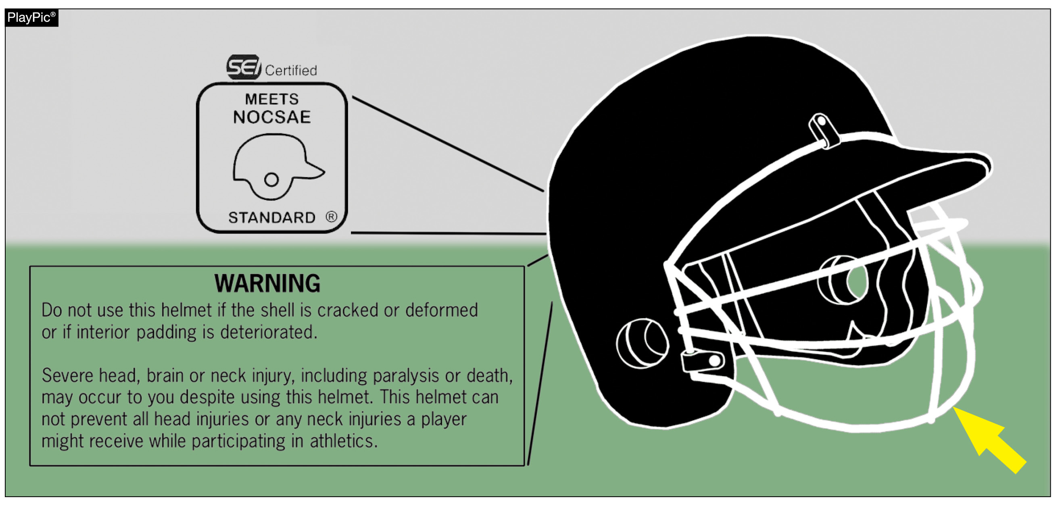
Batting helmets 1-6-6
Batting helmets shall be equipped with a face protector that is certified by SEI to meet the NOCSAE standard.
Notes:
Rule 1-6-6: Batting helmets shall be equipped with a face protector that is certified by SEI to meet the NOCSAE standard.
Rationale: NOCSAE has requested that we modify the language for clarity of the certification process.
Comments:

Slide 18
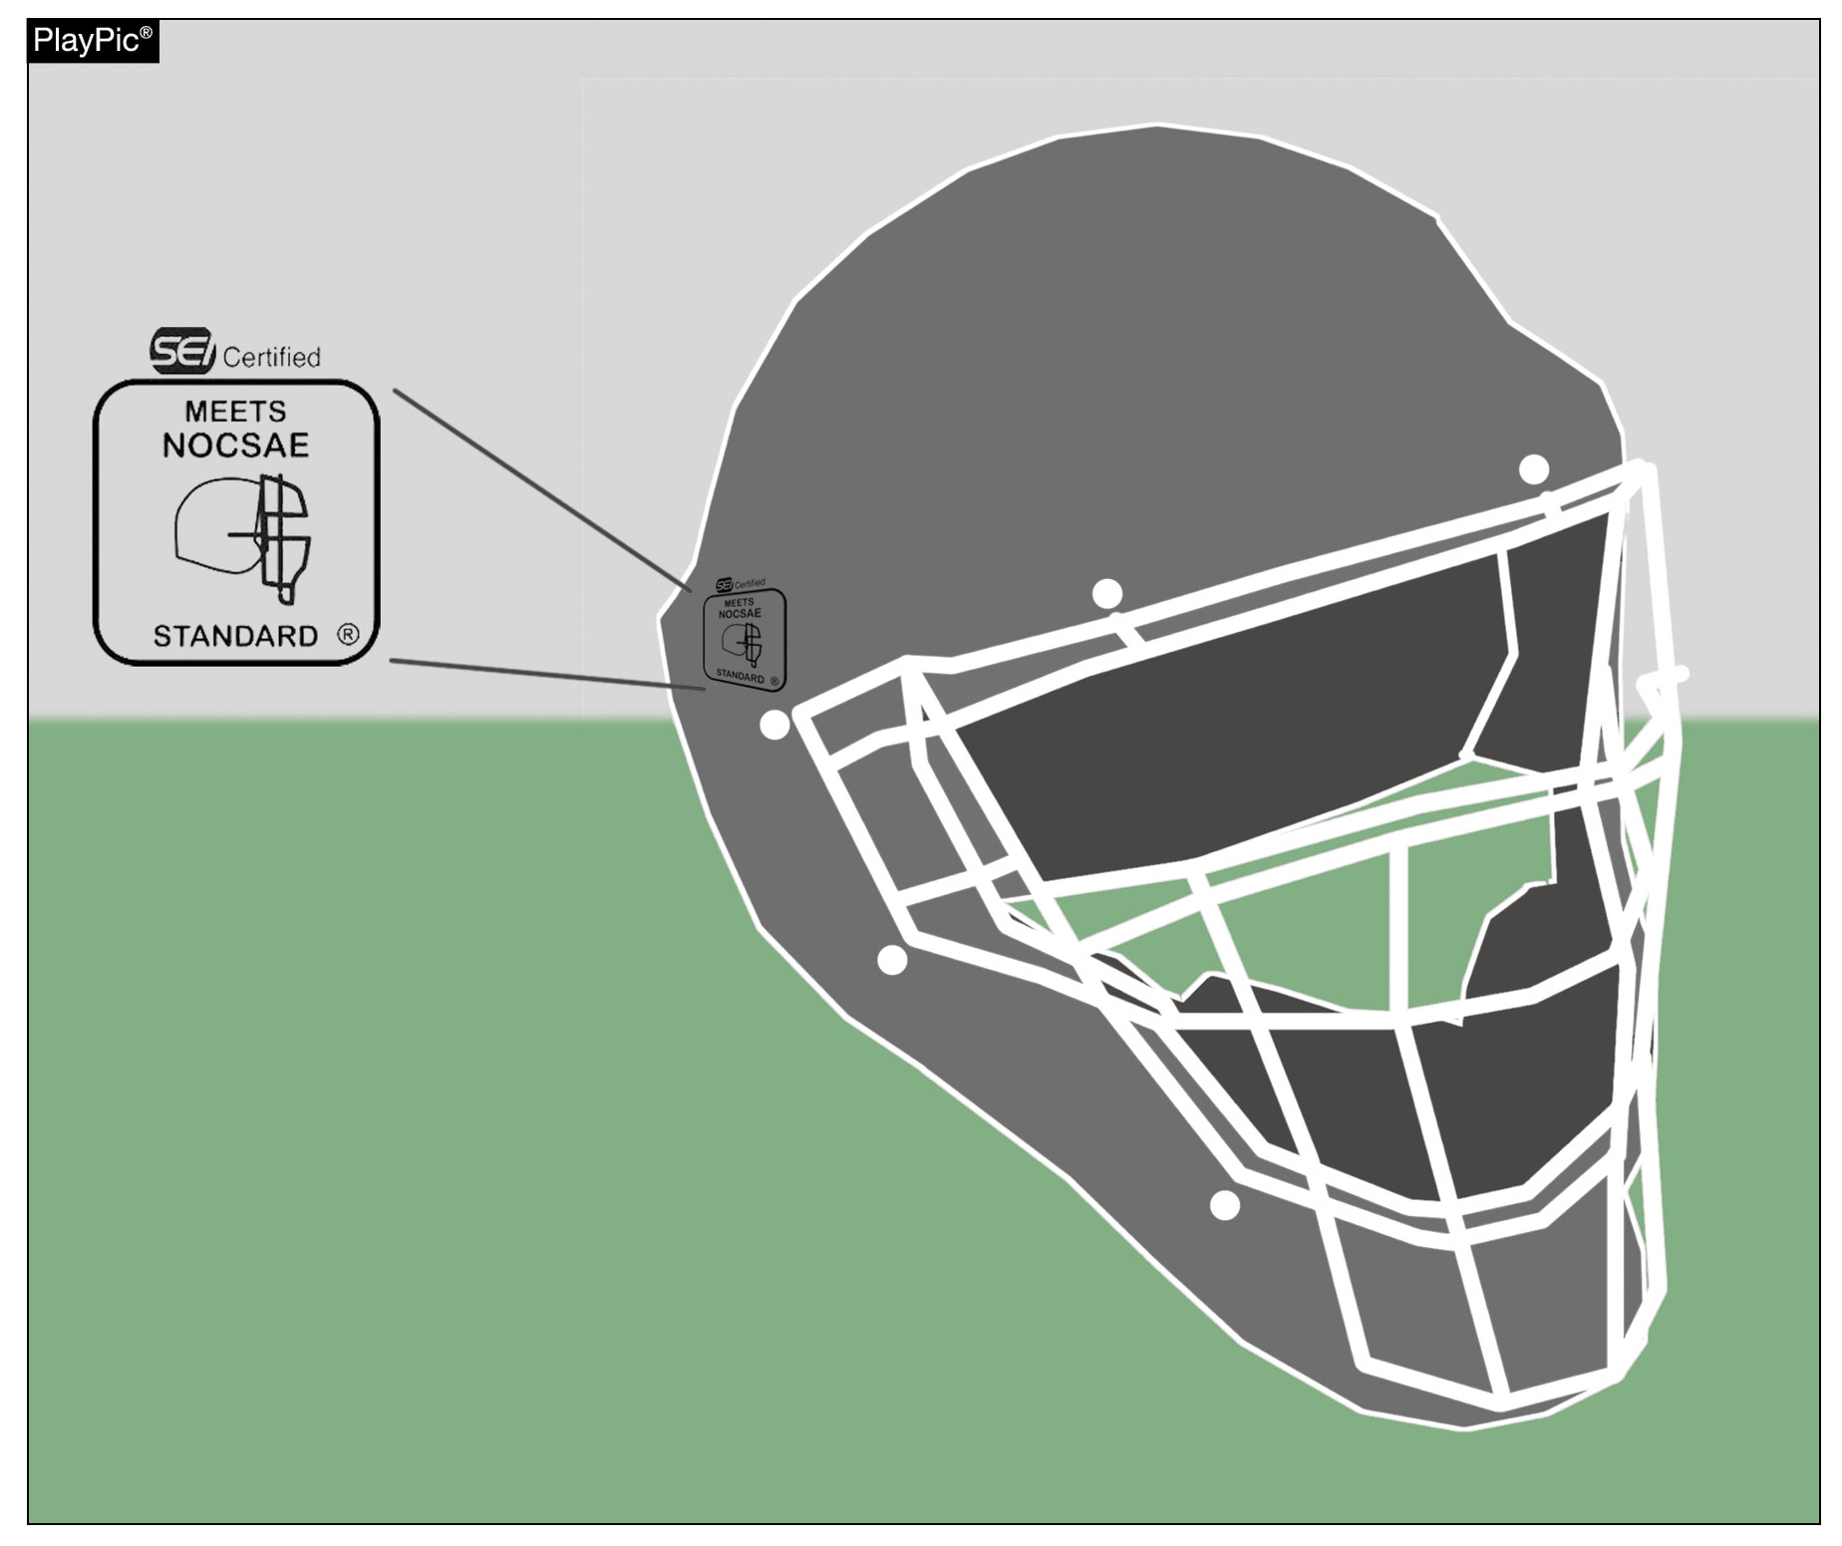
Catcher’s equipment 1-7-1
The catcher shall wear a catcher’s helmet and mask combination that has been certified by SEI to meet the NOCSAE standard at the time of manufacture.
Notes:
Rule 1-7-1: NOCSAE has requested that we modify the language for clarity of the certification process. Rationale: NOCSAE has requested that we modify the language for clarity of the certification process.
Comments:

Slide 19
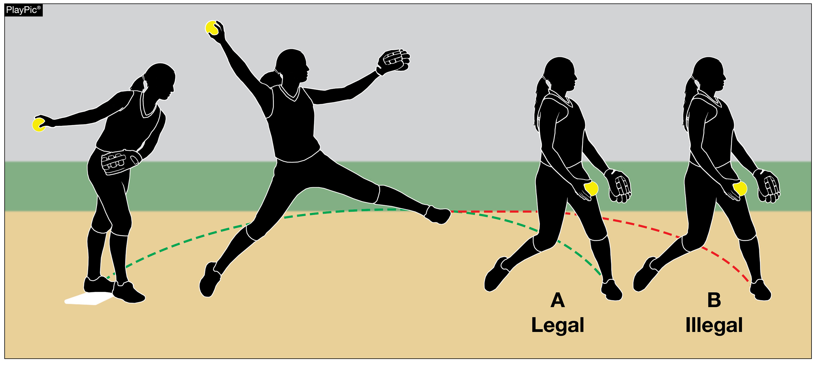
Replant 2-47
A replant of the pivot foot occurs when the pitcher pushes off the playing surface from anywhere other than the pitcher’s plate resulting in the non-pivot foot becoming closer to home plate.
Notes:
Rule 2-47: A replant of the pivot foot occurs when the pitcher pushes off the playing surface from anywhere other than the pitcher’s plate resulting in the non-pivot foot becoming closer to home plate.
Rationale: Replant of the pivot foot occurs when the pitcher pushes off the playing surface from anywhere other than the pitcher’s plate, resulting in the non-pivot foot becoming closer to home plate prior to the act of delivering the pitch. Additional language has been added to align this rule with playing action.
Comments:

Slide 20
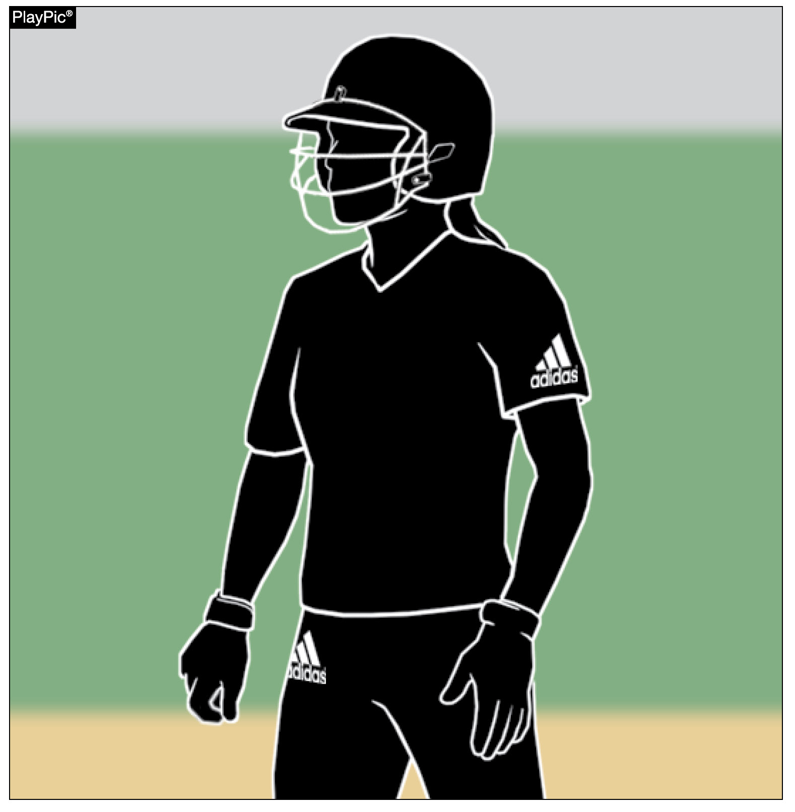
Uniforms, player equipment 3-2-3
Each portion of the school’s official uniform may bear a single manufacturer’s logo/trademark/reference as long as each does not exceed 2 ¼ square inches.
Notes:
Rule 3-2-3: A replant of the pivot foot occurs when the pitcher pushes off the playing surface from anywhere other than the pitcher’s plate resulting in the non-pivot foot becoming closer to home plate.
Rationale: Clarifies requirements for school information on a uniform.
Comments:
Rationale: Beginning January 1, 2027, uniforms may only bear a single manufacturer’s logo, school, name, school logo, mascot and/or the participant’s name. Advertisements, messages, team slogans, etc., will no longer be allowed. Added language – “on each portion”

Slide 21
Bench and field conduct, Umpiring 3-6-12, 10-1-6
The rules prohibiting the use of any form of alcohol, illicit substances or tobacco now include participants, coaches, game officials beginning with the arrival at the competition site until departure from the site following the game.
Notes:
Rules 3-6-12, 10-1-6: The rules prohibiting the use of any form of alcohol, illicit substances or tobacco now include participants, coaches, game officials beginning with the arrival at the competition site until departure from the site following the game.
Rationale: Provides consistent language for NFHS rule books prohibiting the use of alcohol, tobacco, and controlled or illicit substances.
Comments:
Rationale: Beginning January 1, 2027, uniforms may only bear a single manufacturer’s logo, school, name, school logo, mascot and/or the participant’s name. Advertisements, messages, team slogans, etc., will no longer be allowed. Added language – “on each portion”

Slide 22
Dead ball table 5-1
BALL DEAD IMMEDIATELY 19. Awards or Penalties/References 5-1-1i NOTE, 8-4-3h. 20. References 8-4-3i 8-4-3h, Awards or Penalties/References 8-4-3i 8-4-3j
DELAYED DEAD BALL 1. Awards or Penalties The batter is awarded a ball unless the batter reaches first base safely and each other runner advances at least one base, the illegal pitch is nullified. Or if the batter does not reach first base safely or if any base runner fails to advance at least one base, the coach of the team at bat shall have the option of the result of the play or the penalty of the illegal pitch. The pitch is ruled a ball if the ball is not hit or batter becomes base runner. Otherwise, if ball is hit and all runners do not advance one base safely, the team at bat has the choice of accepting the play or penalty.
2. Awards or Penalties/References 6-4 6-1-4 (S.P.)
Notes:
Rules 5-1 Table: BALL DEAD IMMEDIATELY 19. Awards or Penalties/References 5-1-1i NOTE, 8-4-3h. 20. References 8-4-3i 8-4-3h, Awards or Penalties/References 8-4-3i 8-4-3j
DELAYED DEAD BALL 1. Awards or Penalties The batter is awarded a ball unless the batter reaches first base safely and each other runner advances at least one base, the illegal pitch is nullified. Or if the batter does not reach first base safely or if any base runner fails to advance at least one base, the coach of the team at bat shall have the option of the result of the play or the penalty of the illegal pitch. The pitch is ruled a ball if the ball is not hit or batter becomes base runner. Otherwise, if ball is hit and all runners do not advance one base safely, the team at bat has the choice of accepting the play or penalty.
2. Awards or Penalties/References 6-4 6-1-4 (S.P.)
Rationale: Edits to the Dead Ball Table.
Comments:
Rationale: Beginning January 1, 2027, uniforms may only bear a single manufacturer’s logo, school, name, school logo, mascot and/or the participant’s name. Advertisements, messages, team slogans, etc., will no longer be allowed. Added language – “on each portion”

Slide 23
Pitching regulations 6-1-2c
About the pitch:
While pushing off from the pitcher's plate, both feet may be disengaged from the playing surface as long as they remain within the 24-inch length width of the pitcher's plate and do not create a replant of the pivot foot resulting in the pitcher being farther away from the pitcher’s plate. Pushing off with the pivot foot from a place other than the pitcher's plate resulting in the non-pivot foot becoming closer to home plate is illegal.
Notes:
Rules 6-1-2c: While pushing off from the pitcher's plate, both feet may be disengaged from the playing surface as long as they remain within the 24-inch length width of the pitcher's plate and do not create a replant of the pivot foot resulting in the pitcher being farther away from the pitcher’s plate. Pushing off with the pivot foot from a place other than the pitcher's plate resulting in the non-pivot foot becoming closer to home plate is illegal.
Rationale: Aligns the way the 24-inch pitcher’s plate is described in the rules book.
Comments:

Slide 24
The batter becomes a batter-Runner 8-1-2a EFFECTS 3
ART. 2 . . . A batter is awarded first base when: a. fair batted ball strikes the person, attached equipment, or clothing of an umpire or a runner. 3. If before passing a fielder without being touched, the ball is dead. If the runner is hit by the ball while off base and before it has passed an infielder, excluding the pitcher, or if it passes an infielder and another fielder has an opportunity to make an out, the runner is out and the batter-runner is entitled to first base without liability to be put out, and credited with a fielder's choice. When a fair batted ball touches a runner who is in contact with a base, the ball is dead or live depending on whether the closest fielder is in front of the base (live) or behind the base (dead). The runner is not out unless the runner intentionally interferes.
Notes:
Rules 8-1-2a EFFECTS 3: ART. 2 . . . A batter is awarded first base when: a. fair batted ball strikes the person, attached equipment, or clothing of an umpire or a runner. 3. If before passing a fielder without being touched, the ball is dead. If the runner is hit by the ball while off base and before it has passed an infielder, excluding the pitcher, or if it passes an infielder and another fielder has an opportunity to make an out, the runner is out and the batter-runner is entitled to first base without liability to be put out, and credited with a fielder's choice. When a fair batted ball touches a runner who is in contact with a base, the ball is dead or live depending on whether the closest fielder is in front of the base (live) or behind the base (dead). The runner is not out unless the runner intentionally interferes.
Rationale: To better align these rules with the enforcement in rule 8-6-11 that covers the runner’s actions and provides the direct penalty for their actions.
Comments:

Slide 25
The runner is out 8-6-4
The runner physically passes a preceding runner before that runner has been put out. If this was the third out of the inning, any runs scoring prior to the out for passing a preceding runner would count. A runner(s) passing a preceding obstructed runner is not out. (8-4-3b PENALTY 3)
Notes:
Rules 8-6-4: ART. 4 . . . The runner physically passes a preceding runner before that runner has been put out. If this was the third out of the inning, any runs scoring prior to the out for passing a preceding runner would count. A runner(s) passing a preceding obstructed runner is not out. (8-4-3b PENALTY 3)
Rationale: Clarifies which penalty applies to Rule 8-6-4.
Comments:

Slide 26
2025 nfhs softball points of emphasis

Slide 27
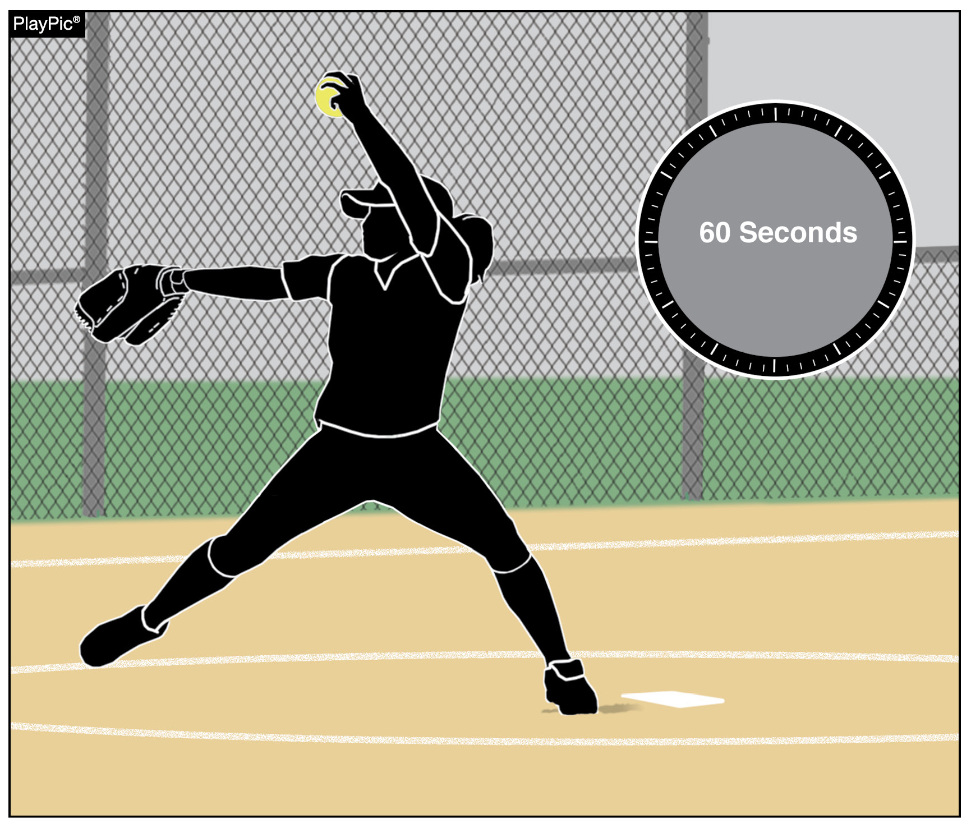
Team’s role in pace of play
There has been a lot of emphasis on pace of play the past several seasons. This year, the focus in on coaches, who play a vital role in created and maintaining pace-of-play standards.
Between innings, 60 seconds is provided for the defense to take the field and throw warm-up pitches. If the catcher was batting when the inning ended, coaches should have another teammate prepared to receive warm-up pitches.
Notes:
TEAM’S ROLE IN PACE OF PLAY Coaches play a vital role in creating and maintaining pace-of-play standards for their individual players and teams. Every effort should be made to educate players on the rules involved and the timing protocols related to breaks between innings, as well as during gameplay. Between innings, 60 seconds is provided for (a) the defense to take the field and throw warm-up pitches, and (b) the offense to prepare to bat.

Slide 28
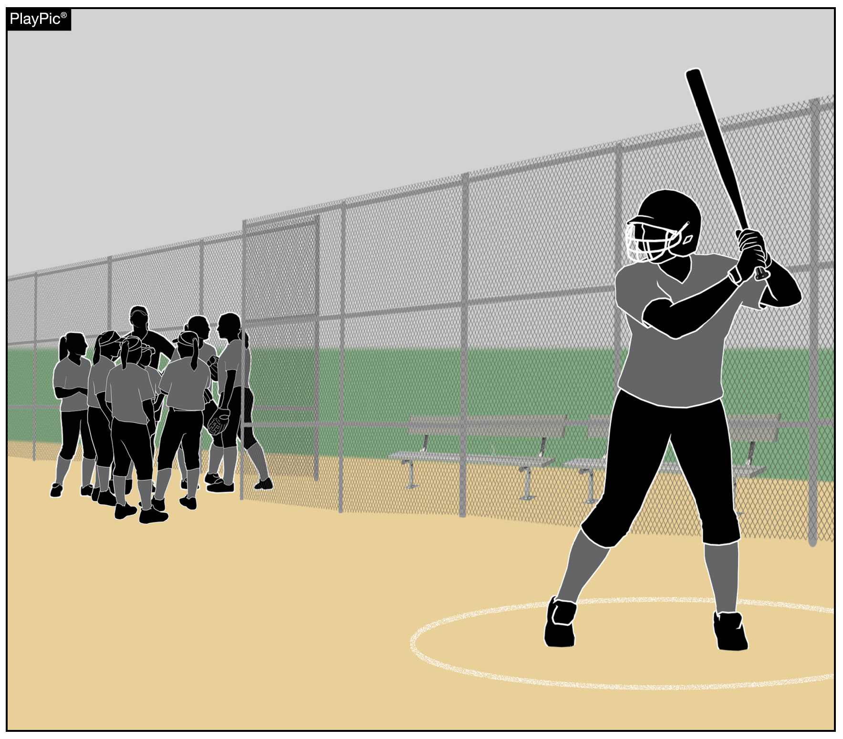
Team’s role in pace of play
The offense also has 60 seconds to prepare to bat. While coaches may choose to huddle with their team as they come off the field, coaches should encourage their lead-off batter to gather their equipment and get ready to bat.
Notes:
TEAM’S ROLE IN PACE OF PLAY There are several ways that coaches can expedite this process with simple instructions to players. For example, if the catcher was batting when the third out was made, have another teammate or coach prepared to receive warm-up pitches while the catcher gets equipped. For the team coming to bat, coaches should encourage their lead-off batter to gather their batting equipment while the remainder of the team huddles in an appropriate area that doesn’t pose a safety risk for the defense warming up.

Slide 29
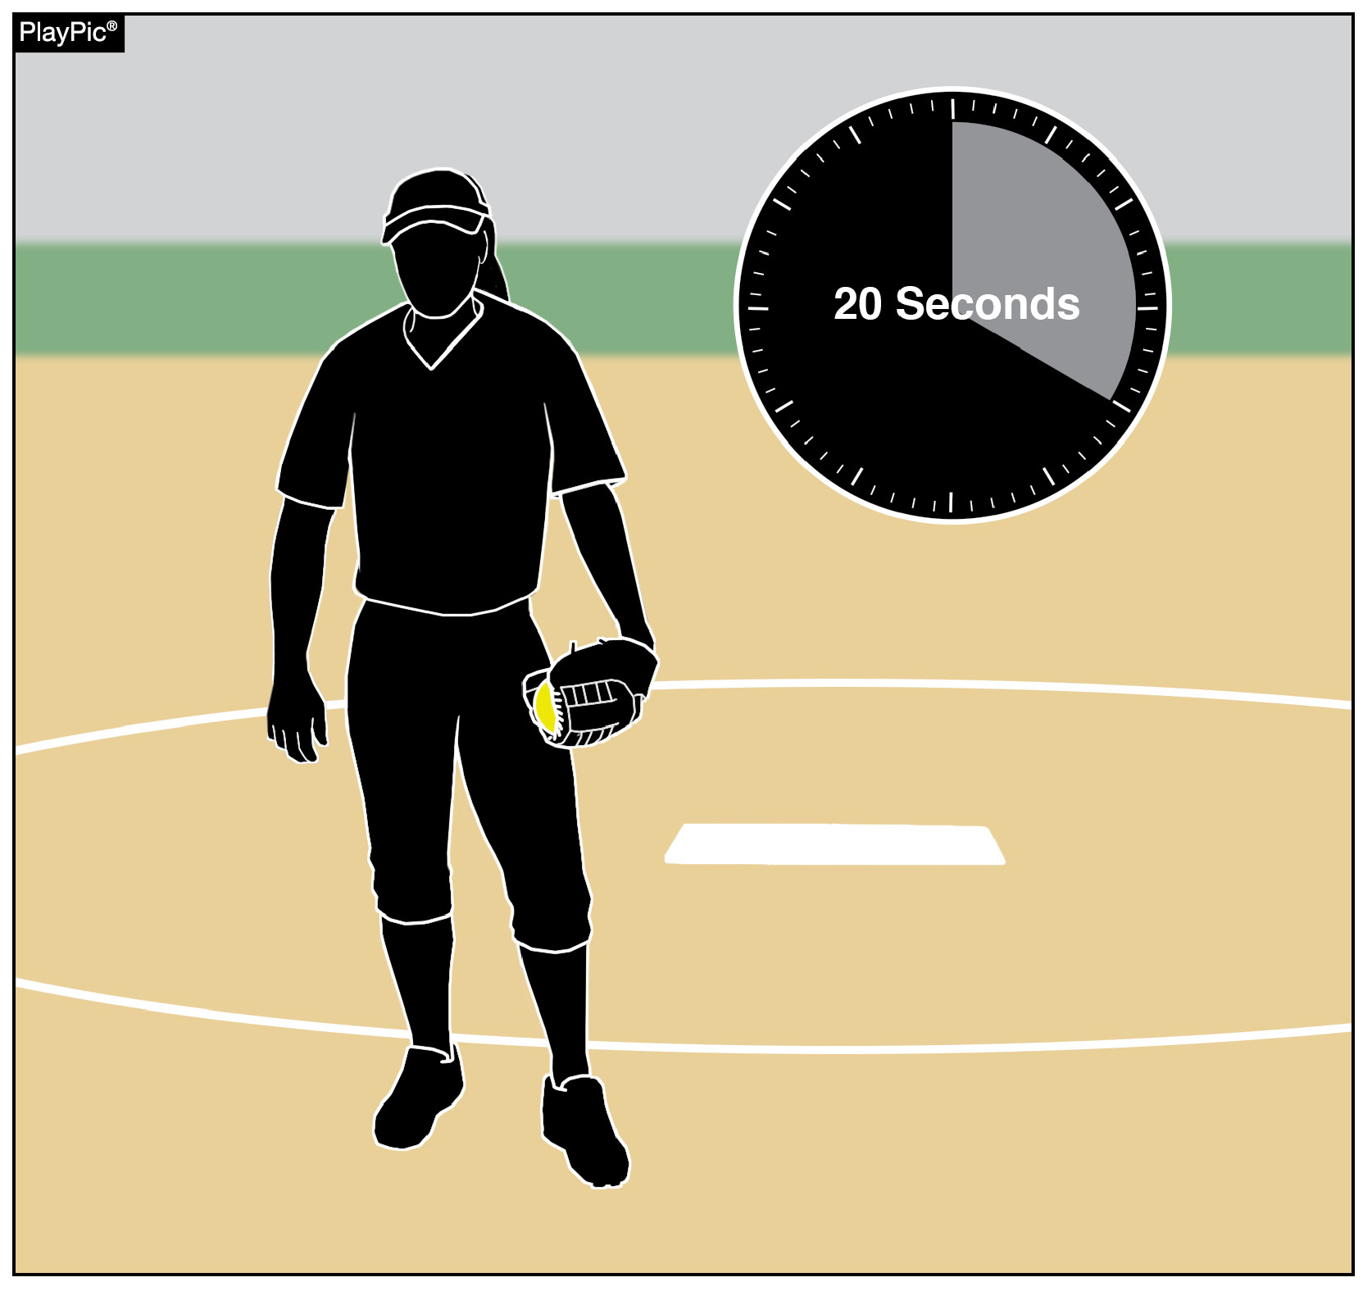
Team’s role in pace of play
Once the 60 seconds between innings has elapsed, the batter has 10 seconds to enter the batter’s box and the pitcher has 20 seconds to legally deliver a pitch.
The pitcher also has 20 seconds to release a pitch once the ball has been returned from a previous pitch and the batter has 10 seconds to enter the batter’s box after the ball is returned.
A ball or strike is added to the count, depending on the tardy party.
Notes:
TEAM’S ROLE IN PACE OF PLAY There are prescribed penalties associated with excessive time between innings. Once the allowed 60 seconds has passed, the offensive team has 10 seconds for its batter to enter the batter’s box (NFHS Rule 7-3-1). Similarly, once the allowed 60 seconds has passed, the pitcher has 20 seconds to legally deliver a pitch (NFHS Rule 6-2-3). These same time constraints exist on each pitch thrown. Once the ball has been returned to the pitcher to prepare for the next pitch, the pitcher has 20 seconds to release the pitch. Coaches who delay in calling pitches risk a penalty for exceeding the allowed 20 seconds. The same applies to the offense when a batter fails to enter the batter’s box within 10 seconds after the ball is returned to the pitcher. The respective penalties for violations of these time constraints are either a strike or a ball on the batter, depending on the tardy party.

Slide 30
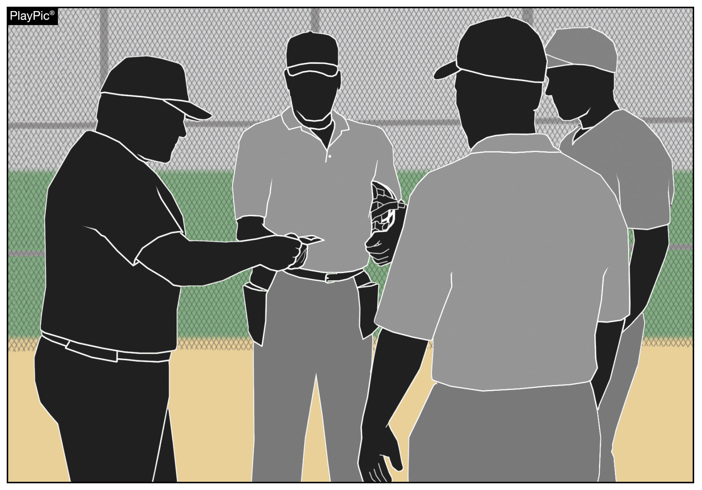
Team’s role in pace of play
Pregame lineup exchanges should be brief and to the point. In order to start games on time, both umpires and coaches should limit talking to pertinent information during this meeting. Remember, this is not meant to be a rules clinic.
Notes:
TEAM’S ROLE IN PACE OF PLAY And finally, pregame lineup exchanges should be brief and to the point. In order to start games on time, both umpires and coaches should limit talking to pertinent information during this meeting. Remember, this is not meant to be a rules clinic.

Slide 31
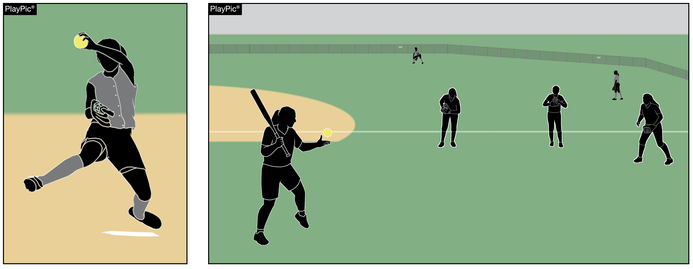
Situational awareness
The safety of all participants is a priority for all involved in game management. All bench and field conduct rules must be enforced, including not allowing the hitting of balls to teammates on defense once the game begins.
Notes:
SITUATIONAL AWARENESS Participant well-being should be a priority for all those involved in game management. Coaches and umpires can help minimize risk and injury to players by understanding and enforcing existing bench and field conduct rules. NFHS rules stipulate that once the game has begun, only the batter, runner(s), on-deck batter, coaches in the coach’s box, bat/ball shaggers or one of the nine players on defense are permitted to be outside the designated dugout/bench or designated warm-up areas (i.e. batting cage or bullpen). Additionally, during game play, hitting the ball to teammates on defense is prohibited.

Slide 32
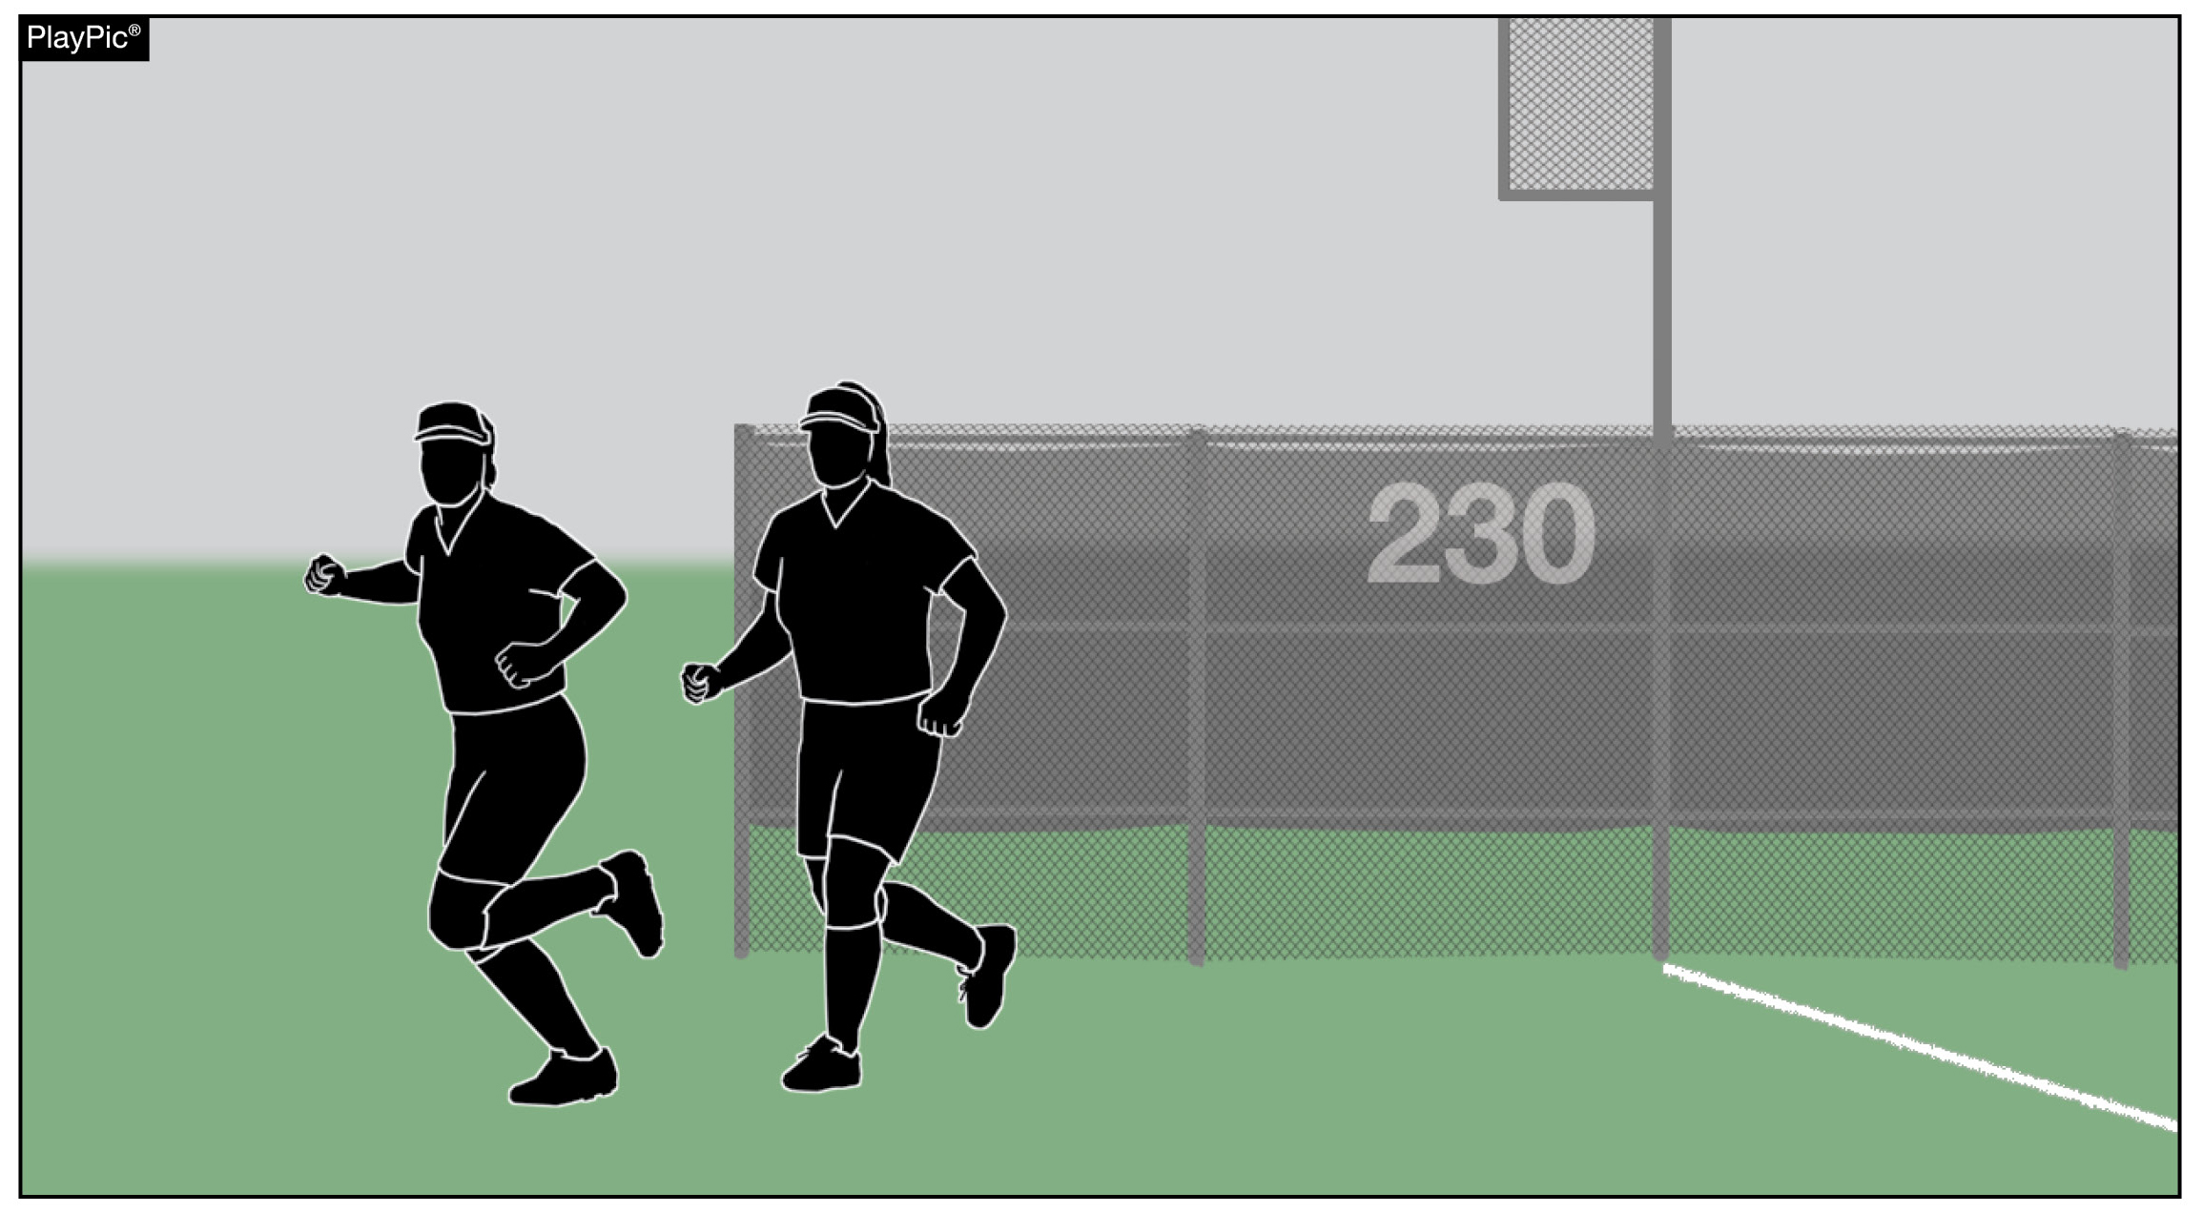
Situational awareness
Between innings, bench personnel are permitted to engage in throwing and running activities.
Notes:
SITUATIONAL AWARENESS
Participant well-being should be a priority for all those involved in game management. Coaches and umpires can help minimize risk and injury to players by understanding and enforcing existing bench and field conduct rules. NFHS rules stipulate that once the game has begun, only the batter, runner(s), on-deck batter, coaches in the coach’s box, bat/ball shaggers or one of the nine players on defense are permitted to be outside the designated dugout/bench or designated warm-up areas (i.e. batting cage or bullpen). Additionally, during game play, hitting the ball to teammates on defense is prohibited. Between innings, bench personnel are permitted to engage in throwing and running activities.

Slide 33
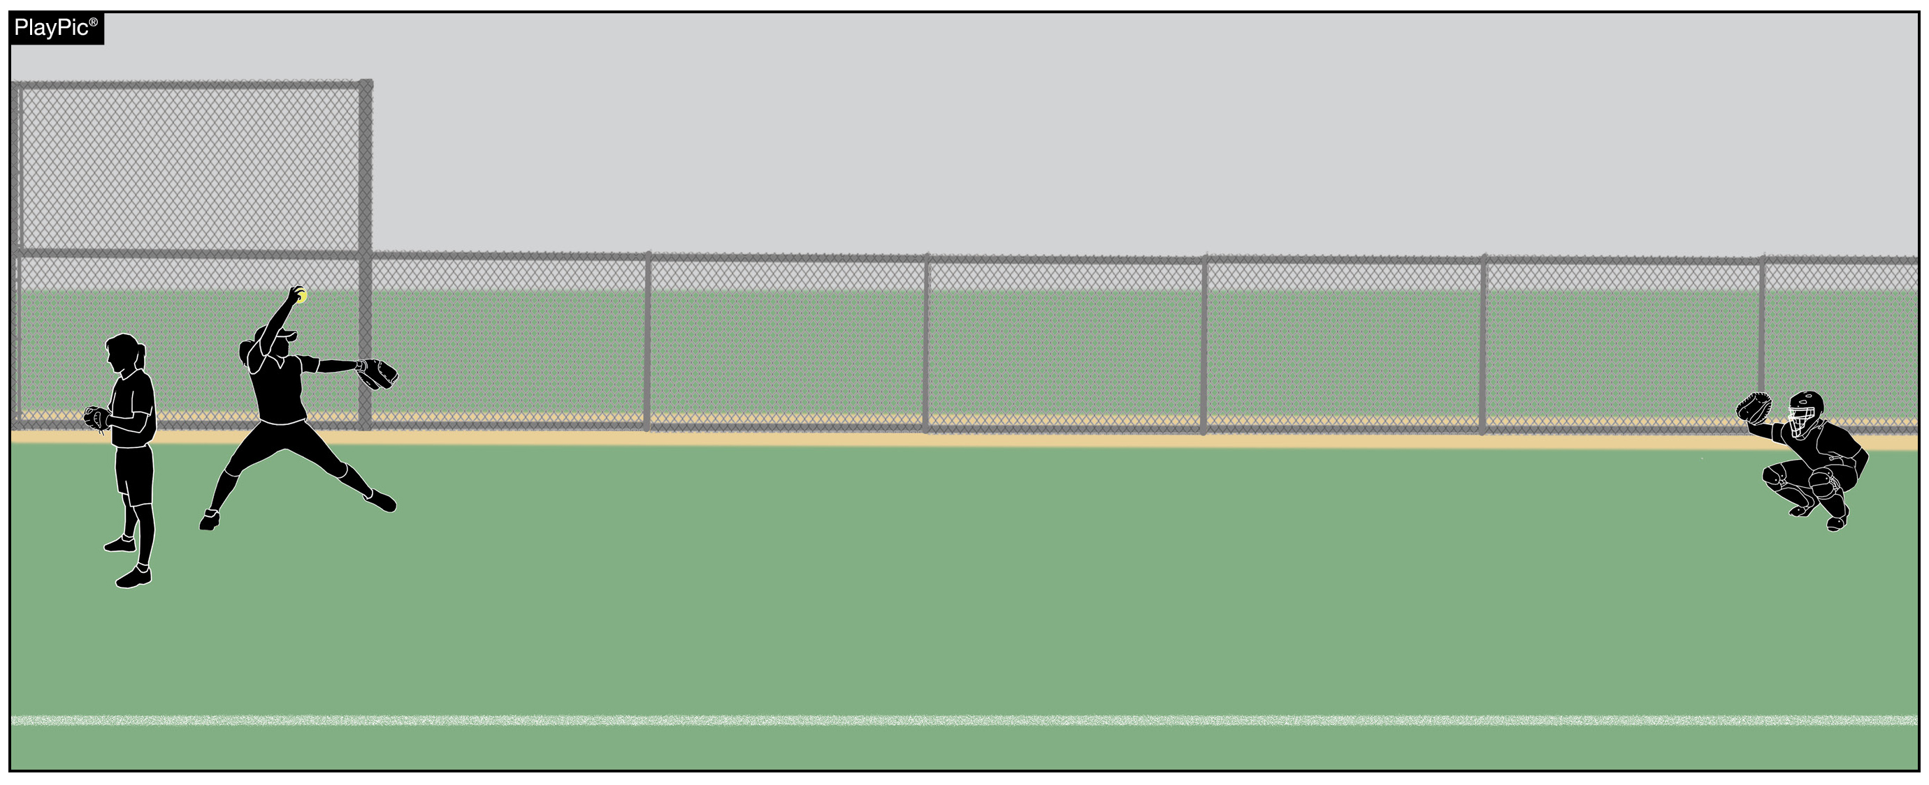
Situational awareness
If a bullpen is in an area where a foul ball or overthrow could contact a pitcher or catcher, the team should assign bench personnel with a glove to stand nearby to shield those warming up.
Notes:
SITUATIONAL AWARENESS Field structure and dugout protection vary from facility to facility. Team personnel should assess and be aware of potential hazards associated with foul balls and overthrows. For example, if a bullpen is in an area where a foul ball or overthrow could contact the pitcher or catcher, the team might assign bench personnel with a glove to stand nearby to shield those warming up.

Slide 34
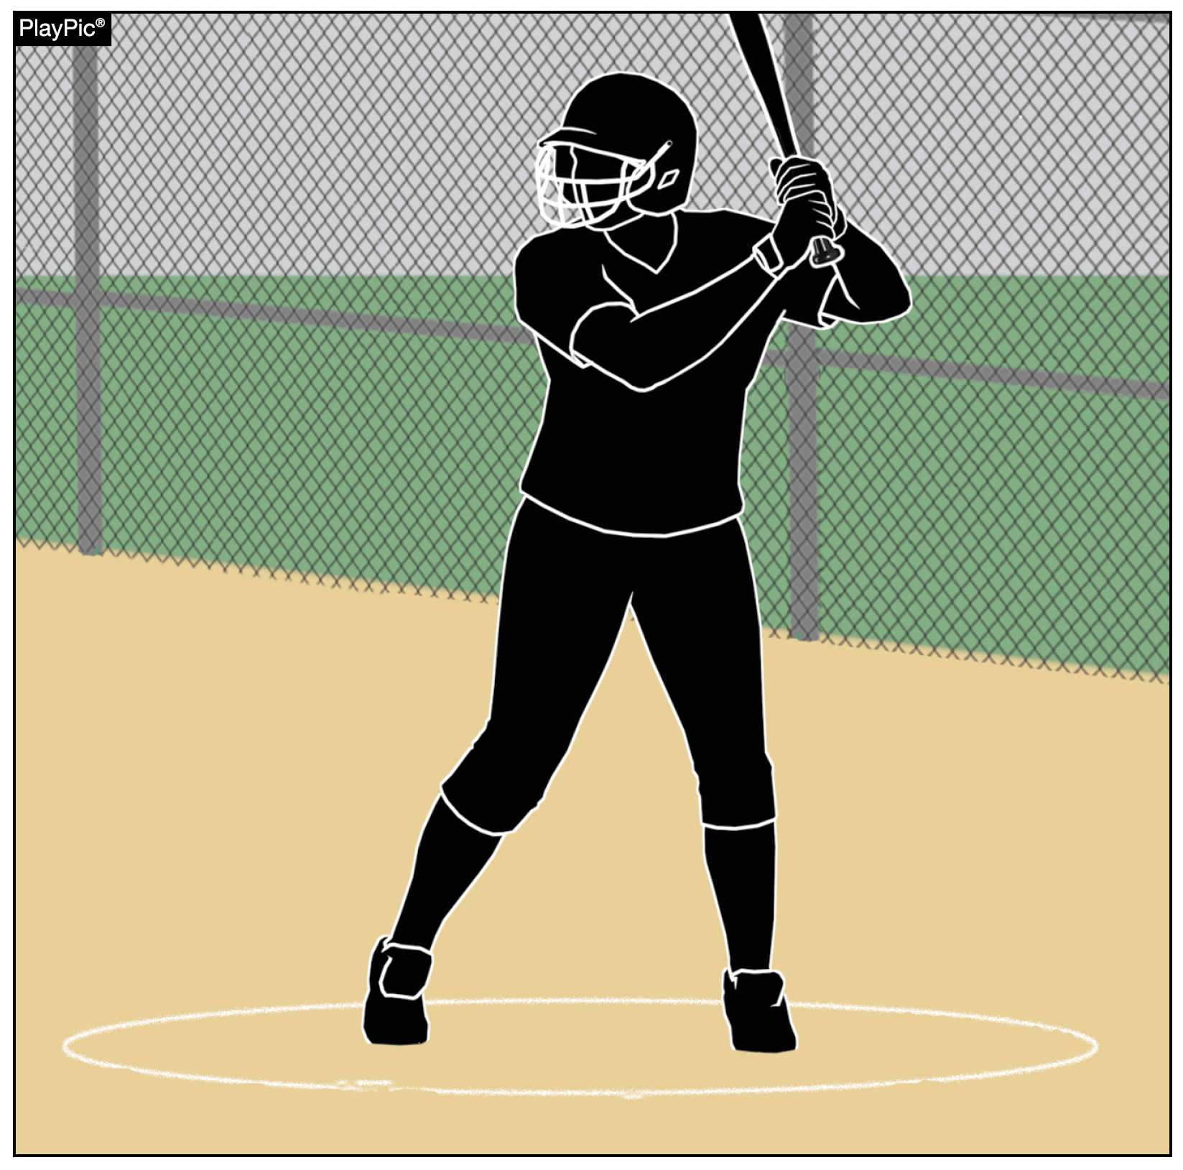
Situational awareness
On-deck batters should be aware of potential foul balls and overthrows and be prepared to move as necessary to avoid contact.
By rule, on-deck batters MUST use the on-deck circle closest to their own dugout.
Notes:
SITUATIONAL AWARENESS On-deck batters should be mindful of potential foul balls and overthrows and be prepared to move as necessary to avoid contact. On-deck batters must use the on-deck circle closest to their own dugout.

Slide 35
NFHS OFFICIALS Education

Slide 36
All things officiating in one place!
The all-in-one, cloud-based NFHS Center for Officials Services (COS) connects everyone associated with officiating. The COS handles registration, assignments, testing, payments, and a host of other features and integrations that consolidate all officiating needs into a single, modern solution. Free to all NFHS state associations, local associations, and assigner groups.
20+
Member States
300,000+
Officials
7,000+
Schools

Slide 37
COS Continued Improvements
Over 200 Updates and New Features in the Past 12 Months!
COMING SOON
Exam Center Improvements
Streamlined Registrations and Onboarding
Expanded Reporting Capabilities for States
Event/Clinic Registration and Attendance Tracking
Reciprocity
In-State/Out-of-State
Watch for Many More Updates from NFHS!

Slide 38
www.nfhs.org
Notes:
UMPIRING SOFTBALL In partnership with USA Softball, the NFHS has developed the first in a line of educational softball courses. This first course addresses game management as well as obstruction and interference.

Slide 39
NFHS Learning Center

Slide 40
Notes:
The NFHS Learning Center is the home to more than 90 online professional development courses for everyone within the interscholastic community - coaches, students, officials, parents, administrators, and individuals within performing arts programs. More than 60 courses are available for free.
The NFHS is an Accredited Institution and has delivered more than 15 million courses on its NFHS Learning Center platform since its inception in 2007. In receiving national accreditation by Cognia, the NFHS has upheld itself to rigorous standards that focus on productive learning environments, equitable resource allocation that meet the needs of learners, and effective leadership.
The NFHS Learning Center features its flagship coaching course, “Fundamentals of Coaching,” as well as several health and safety courses that have been completed by millions of individuals, such as “Concussion in Sports,” “Heat Illness Prevention,” “Sudden Cardiac Arrest” and “Protecting Students from Abuse.” The NFHS Learning Center offers several national credentials that can be earned by individuals who complete specific NFHS courses. Through the School Honor Roll Program, schools can earn a physical banner to hang in their school.
To learn more and start your professional development journey, please visit the NFHS Learning Center at NFHSLearn.com.

Slide 41
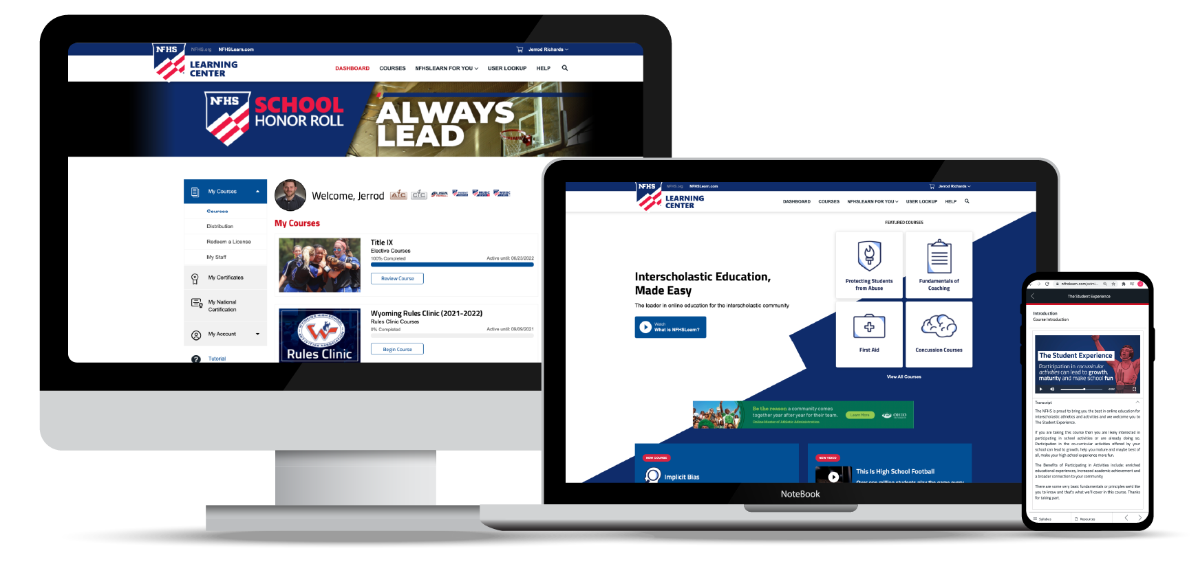
Over 21 million courses delivered!
Concussion in Sports – 7.2M+
Heat Illness Prevention – 2.2M+
Sudden Cardiac Arrest – 2.4M+
Concussion for Students – 1.2M+
The Collapsed Student (2020) – 67,550+
CPR & AED Training (2023) – 9,300+
Sportsmanship – 1M+
Fundamentals of Coaching – 928,000+
First Aid, Health and Safety – 418,000+
Bullying, Hazing and Inappropriate Behaviors – 425,000+
Student Mental Health and Suicide Prevention – 250,000+
Protecting Students from Abuse – 250,000+
Implicit Bias (2021) – 96,000+

Slide 42
Coaching Softball
$50
Identify stages of the throwing motion and recognize the proper receiving body position
Understand the mechanics of hitting, baserunning, leads and sliding
Identify key elements of the swing including phases and positions
Recognize the starting positions and footwork for all players
Identify defensive responsibilities and tactics for all positions
Available at
Notes:
The NFHS partnered with USA Softball to present the online Coaching Softball course. Go to www.nfhslearn.com to view the trailer, description and outline for this course, and encourage your coaches to sign-up today!

Slide 43
NFHS Network

Slide 44
NFHS Network
By 2025, every high school sporting event in America will be streamed live.
The NFHS Network will be THE DESTINATION for fans to view these broadcasts.
27 Different Sports and Activities
www.NFHSnetwork.com
Notes:
The NFHS Network is the leader in streaming Live and On Demand high school sports.
Partnered with the National Federation of State High School Associations, 45 high school state athletic/activities associations, and PlayOn! Sports, the NFHS Network is a joint venture created to provide fans with the ability to stream high school sports on any device, from wherever they are.
All NFHS Network events are available to watch online at www.NFHSnetwork.com and through the NFHS Network Live App for iOS and Android. Follow us on Facebook, Twitter, Instagram, and YouTube.
Watching high school sports and events has never been easier.
The NFHS Network’s goal to broadcast live all 2 million high school sporting events by 2025.
The NFHS Network covers 27 different regular season and postseason sports, as well as other high school activities, celebrating the accomplishments of students-athletes, student broadcasters, and high schools across the country.

Slide 45
Over 1 million events this year…
Notes:
The NFHS Network will broadcast over 150,000 live events this year. If your school is not a member of the NFHS Network School Broadcast Program, please contact us at Mark.Koski@NFHSnetwork.com

Slide 46
Nfhs Authentication Mark Update

Slide 47
NFHS Authenticating Mark update
Specifications
Do not use the NFHS Authenticating Mark without prior written approval from the NFHS
This mark is for use of licensees only.
Minimum size
Inflatable Balls - 2 ½" (Basketball, Football, Soccer, Volleyball, and Water Polo)
Non-Inflatable Balls - 1 ¼" (Baseball, Field Hockey, Ice Hockey Puck, Lacrosse, and Softball)
On a ball or puck, the NFHS logo may be smaller than manufacturer’s logo, but should be placed in proximity to the manufacturer’s name for easy identification. Allow enough space around the logo so it can be easily recognized as distinct and separate.
Reproduce the logo only from the vector artwork provided here or on Direct Licensing Hub. Do not copy, scan art electronically or use as a template to redraw the symbol.
Note: If sizing or specifications do not work well in your particular design situation, contactK12 Licensing.
Current Logos
New Logo

Slide 48
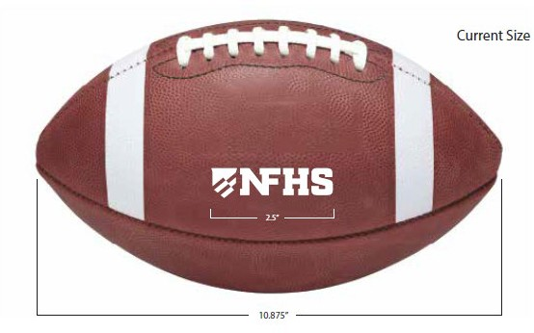
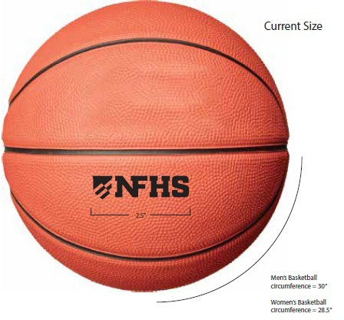
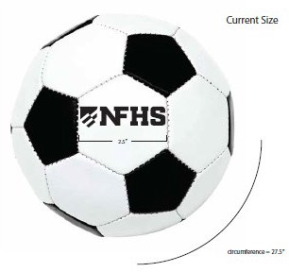
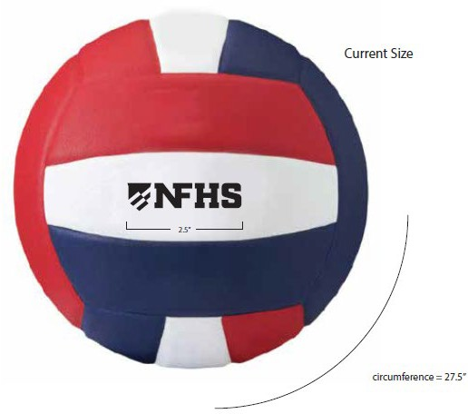
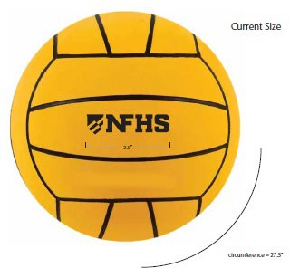
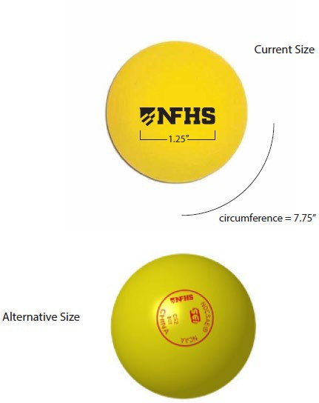
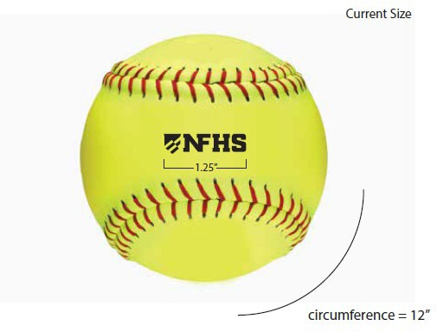
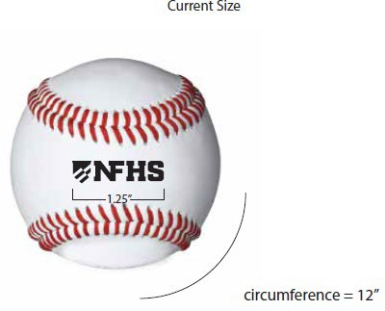
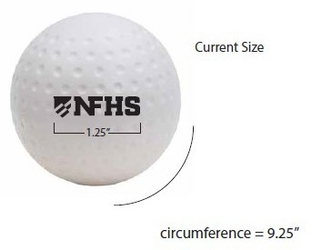
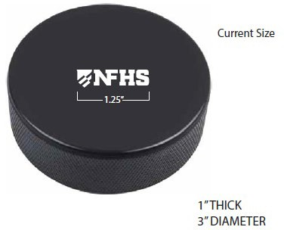
NFHS Authenticating Mark update
A current list of NFHS authenticated products can be found at www.nfhs.org, Resources, Authenticating Mark.

Slide 49
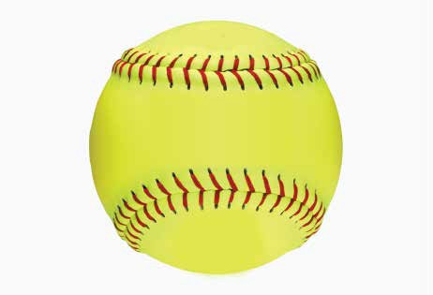
Softball
Old Size
Current Size
OR
1.25”

Slide 50
Nfhs softball resources

Slide 51
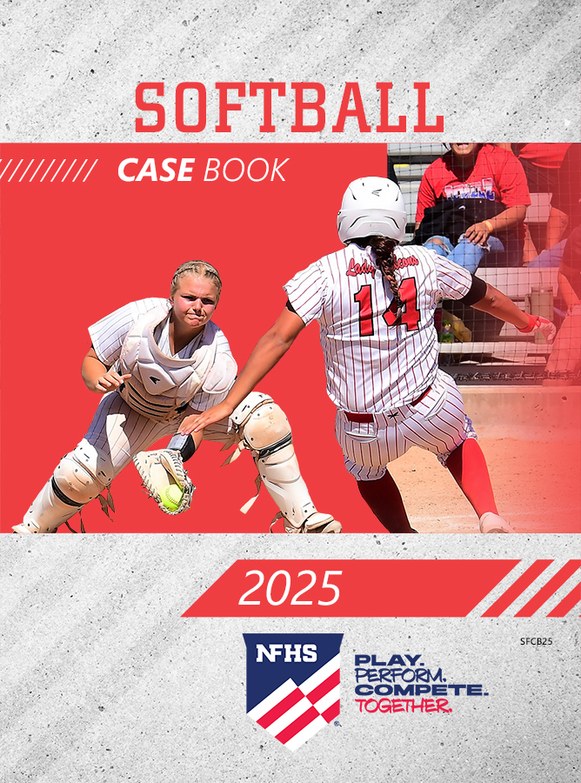
nfhs softball resources
NFHS Rules Books, Case Books and other softball resources can be ordered:
online at www.nfhs.com or
by calling 1-800-776-3462
Notes:
NFHS SOFTBALL PUBLICATIONS
The NFHS softball publications are available to order online or by using the toll-free number.

Slide 52
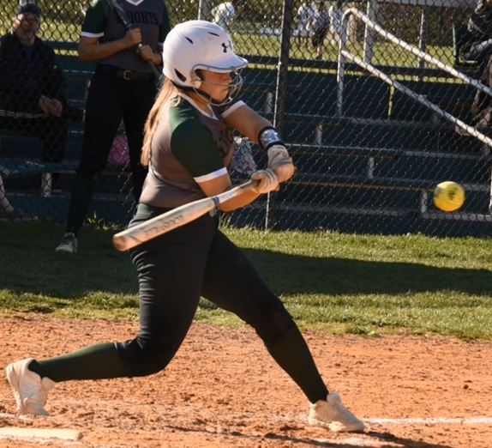
nfhs softball resources
Rules Power Points
Weekly Rule Interpretations
Mid-Season Meetings
Virtual Case Book
Softball Illegal Player Penalty Chart

Slide 53
Thank You
National Federation of State High School Associations PO Box 690 | Indianapolis, IN 46206 Phone: 317-972-6900 www.nfhs.org | www.nfhslearn.com | www.nfhsnetwork.com

